Slide 1
Chapter 2 Introduction to HTML5
Internet & World Wide Web How to Program, 5/e

Slide 2
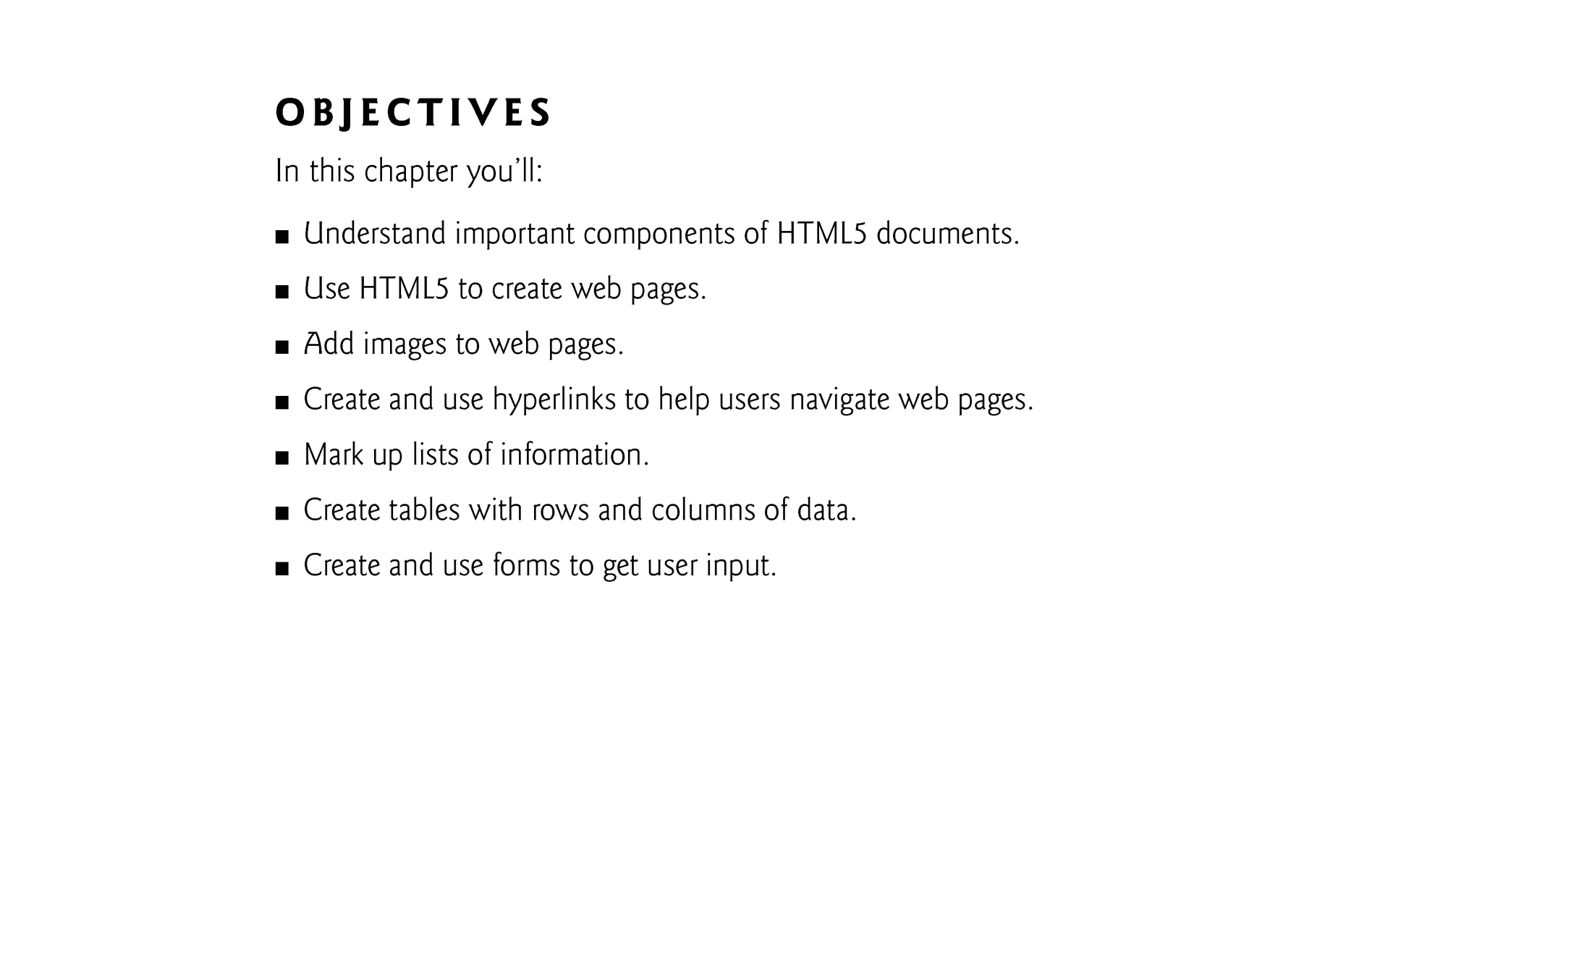

Slide 3
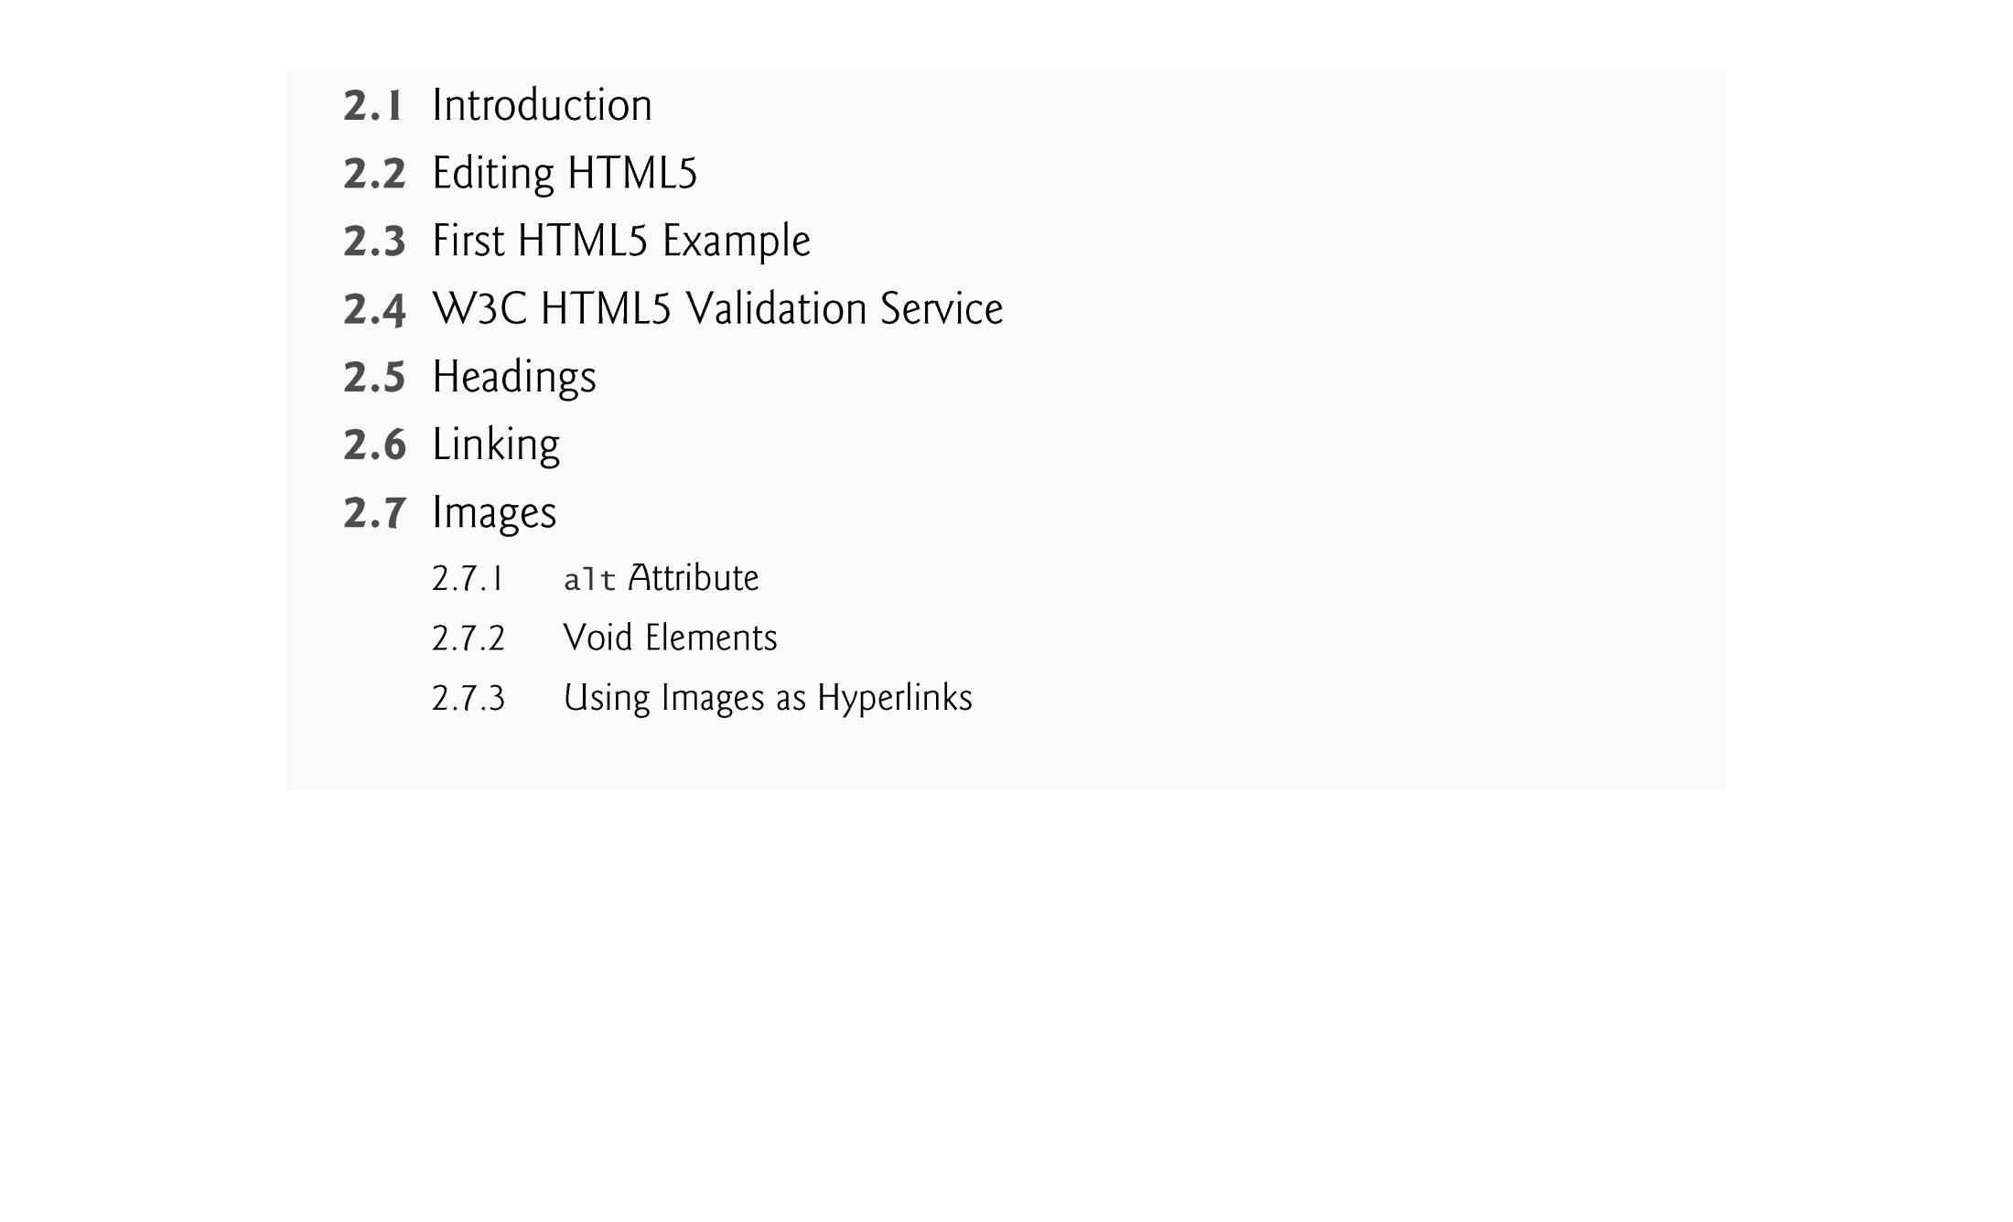

Slide 4
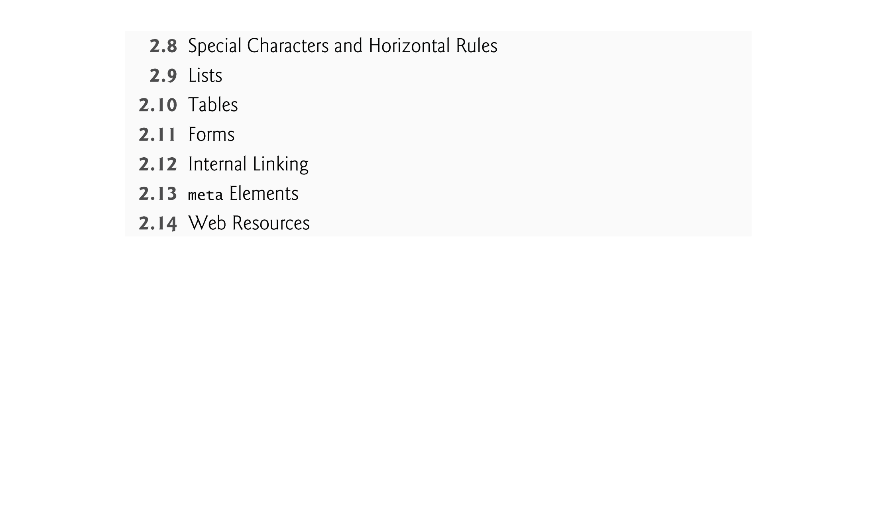

Slide 5
2.1 Introduction
HTML5 (HyperText Markup Language 5)
markup language that specifies the structure and content of documents that are displayed in web browsers
We introduce some basics, then cover more sophisticated HTML5 techniques such as:
tables, which are particularly useful for structuring information from databases (i.e., software that stores structured sets of data)
forms for collecting information from web-page visitors
internal linking for easier page navigation
meta elements for specifying information about a document

Slide 6
2.2 Editing HTML5
We’ll create HTML5 documents by typing HTML5 markup text in a text editor (such as Notepad, TextEdit, vi, emacs) and saving it with the .html or .htm filename extension.
Computers called web servers store HTML5 documents.
Clients (such as web browsers running on your local computer or smartphone) request specific resources such as HTML5 documents from web servers.

Slide 7
2.3 First HTML5 Example
Figure 2.1 is an HTML5 document named main.html, which is stored in the examples/ch02 folder.
This first example displays the message Welcome to HTML5! in the browser.
https://www.w3schools.com/tags/

Slide 8
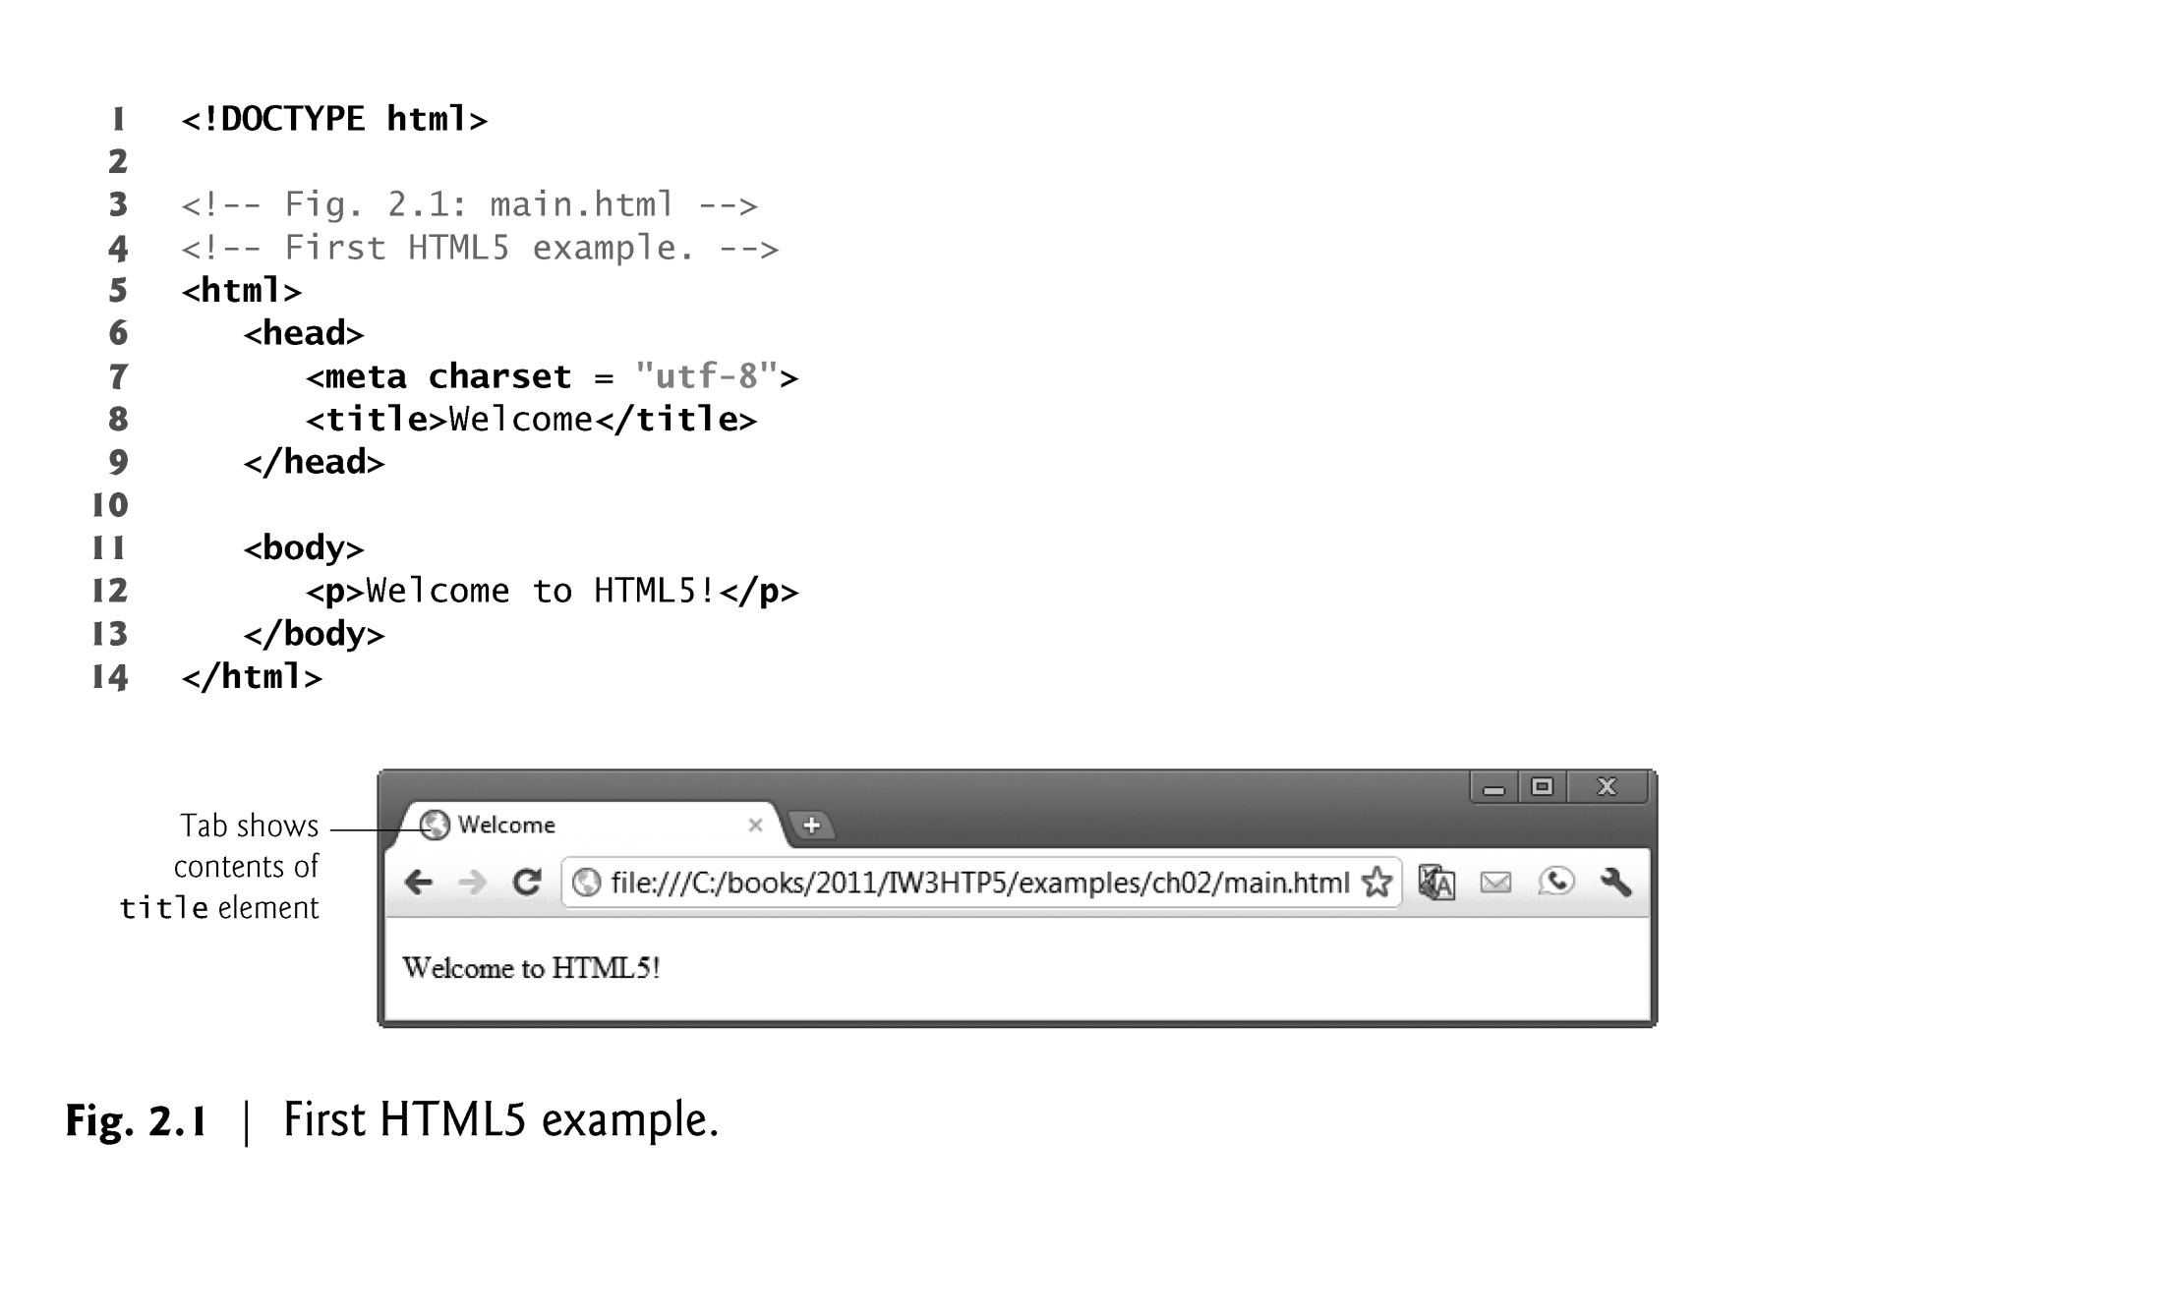

Slide 9
2.3 First HTML5 Example
Document Type Declaration
The document type declaration (DOCTYPE) is required in HTML5 documents so that browsers render the page in standards mode.
Some browsers operate in quirks mode to maintain backward compatibility with web pages that are not up-to-date with the latest standards.

Slide 10
2.3 First HTML5 Example
Comments
Insert comments in your HTML5 markup to improve readability and describe the content of a document.
The browser ignores comments when your document is rendered.
Comments start with <!-- and end with -->.

Slide 11
2.3 First HTML5 Example
html, head and body Elements
HTML5 markup contains text (and images, graphics, animations, audios and videos) that represents the content of a document and elements that specify a document’s structure and meaning.
The html element encloses the head section (represented by the head element) and the body section (represented by the body element).
The head section contains information about the HTML5 document, such as the character set (UTF-8, the most popular character-encoding scheme for the web) that the page use—which helps the browser determine how to render the content—and the title.
The head section also can contain special document-formatting instructions called CSS3 style sheets and client-side programs called scripts for creating dynamic web pages.
The body section contains the page’s content, which the browser displays when the user visits the web page.

Slide 12
2.3 First HTML5 Example (cont.)
Start Tags and End Tags
HTML5 documents delimit most elements with a start tag and end tag.
A start tag consists of the element name in angle brackets
For example, <html>
An end tag consists of the element name preceded by a forward slash (/) in angle brackets
For example, </html>
There are several so-called “void elements” that do not have end tags.
Many start tags have attributes that provide additional information about an element, which browsers use to determine how to process the element.
Each attribute has a name and a value separated by an equals sign (=).

Slide 13
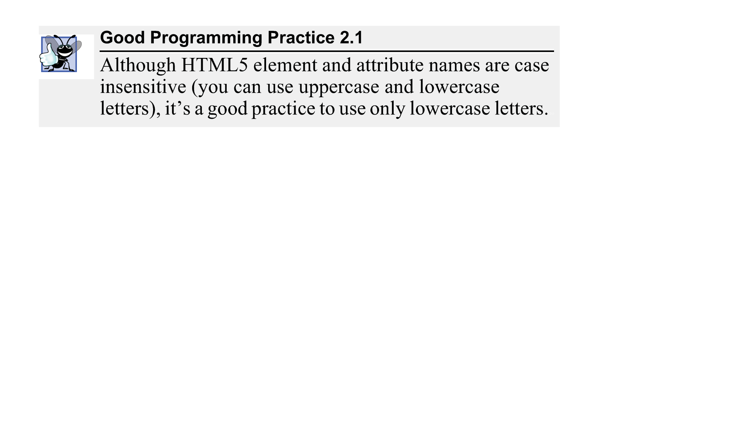

Slide 14
2.3 First HTML5 Example (Cont.)
Title Element
The title element is called a nested element, because it’s enclosed in the head element’s start and end tags.
The head element is also a nested element, because it’s enclosed in the html element’s start and end tags.
The title element describes the web page.
Titles usually appear in the title bar at the top of the browser window, in the browser tab on which the page is displayed, and also as the text identifying a page when users add the page to their list of Favorites or Bookmarks, enabling them to return to their favorite sites.
Search engines use the title for indexing purposes and when displaying results

Slide 15


Slide 16
2.3 First HTML5 Example (Cont.)
Paragraph Element (<p>...</p>)
All text placed between the <p> and </p> tags forms one paragraph.

Slide 17
2.4 W3C HTML5 Validation Service
HTML5 documents that are syntactically correct are guaranteed to render properly
HTML5 documents that contain syntax errors may not display properly
Validation services (e.g., validator.w3.org/#validate-by-upload) ensure that an HTML5 document is syntactically correct

Slide 18
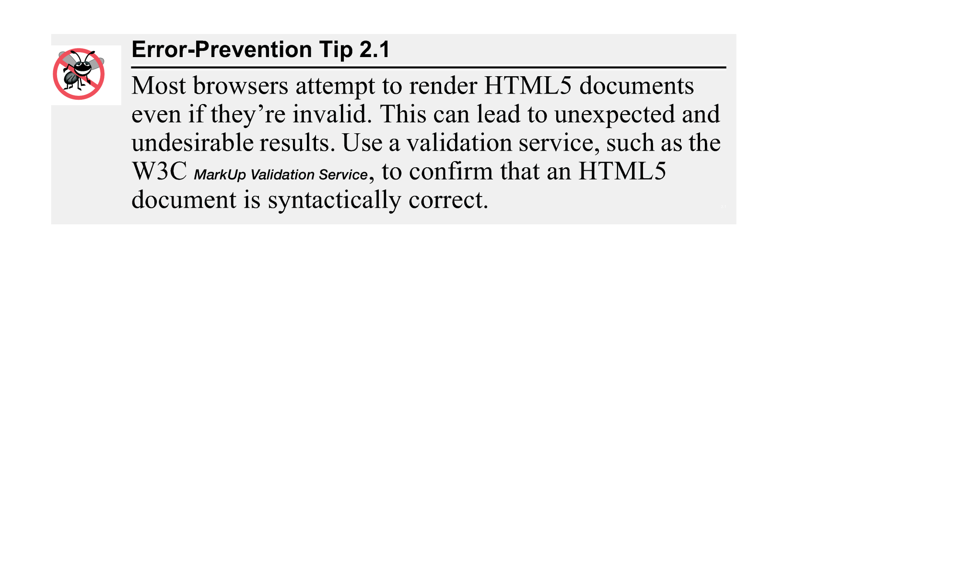

Slide 19
2.5 Headings
HTML5 provides six heading elements (h1 through h6) for specifying the relative importance of information
Heading element h1 is considered the most significant heading and is rendered in the largest font.
Each successive heading element (i.e., h2, h3, etc.) is rendered in a progressively smaller font.

Slide 20
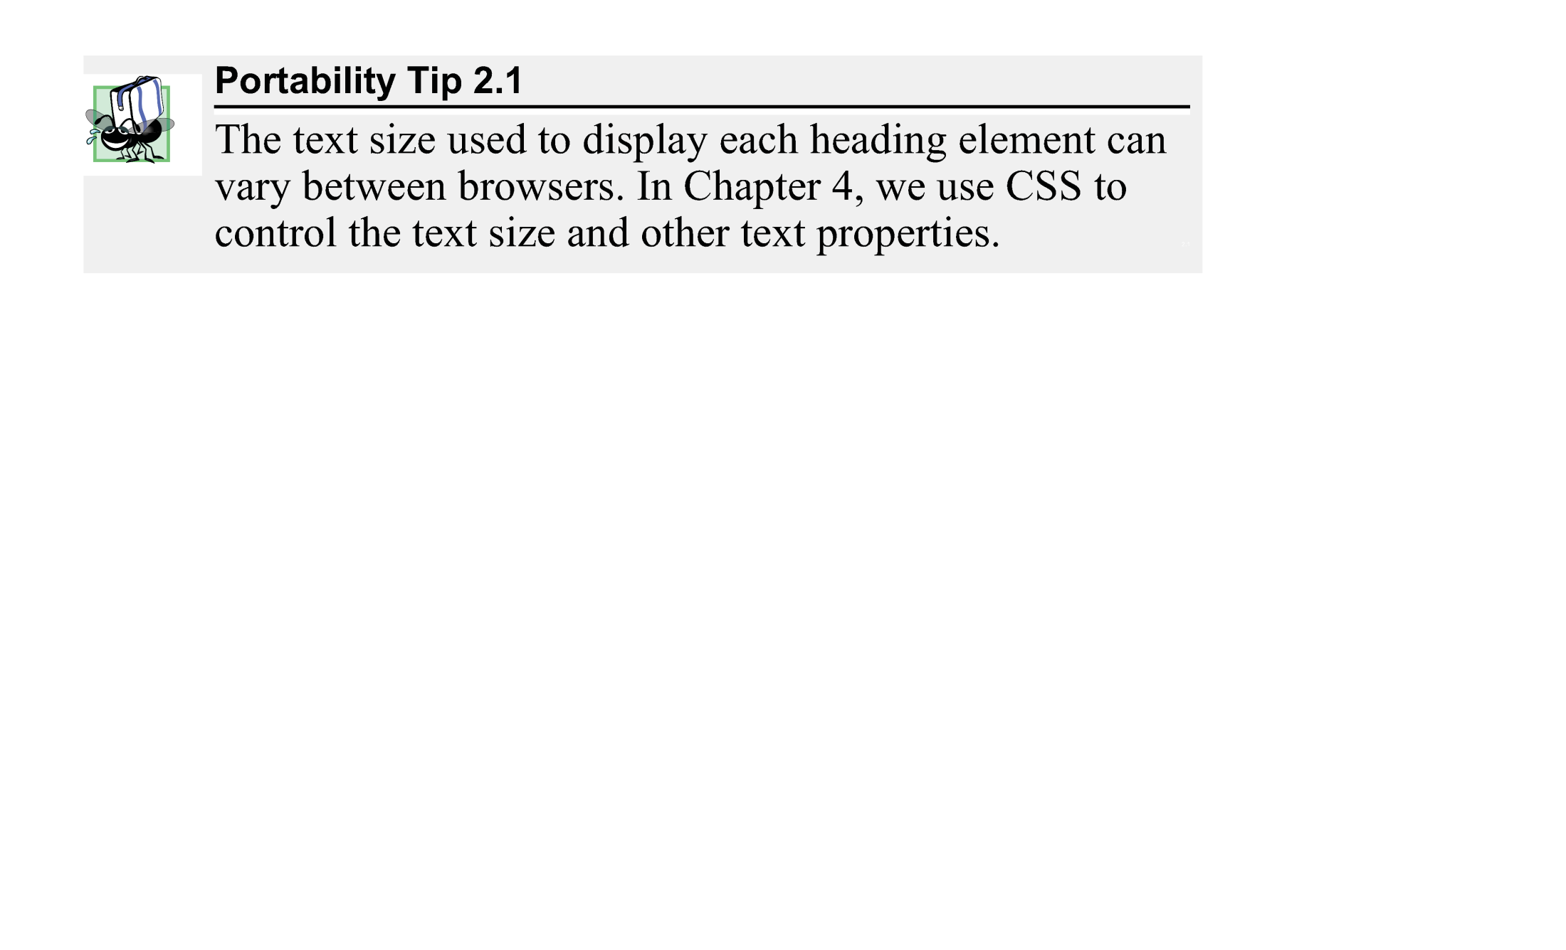

Slide 21
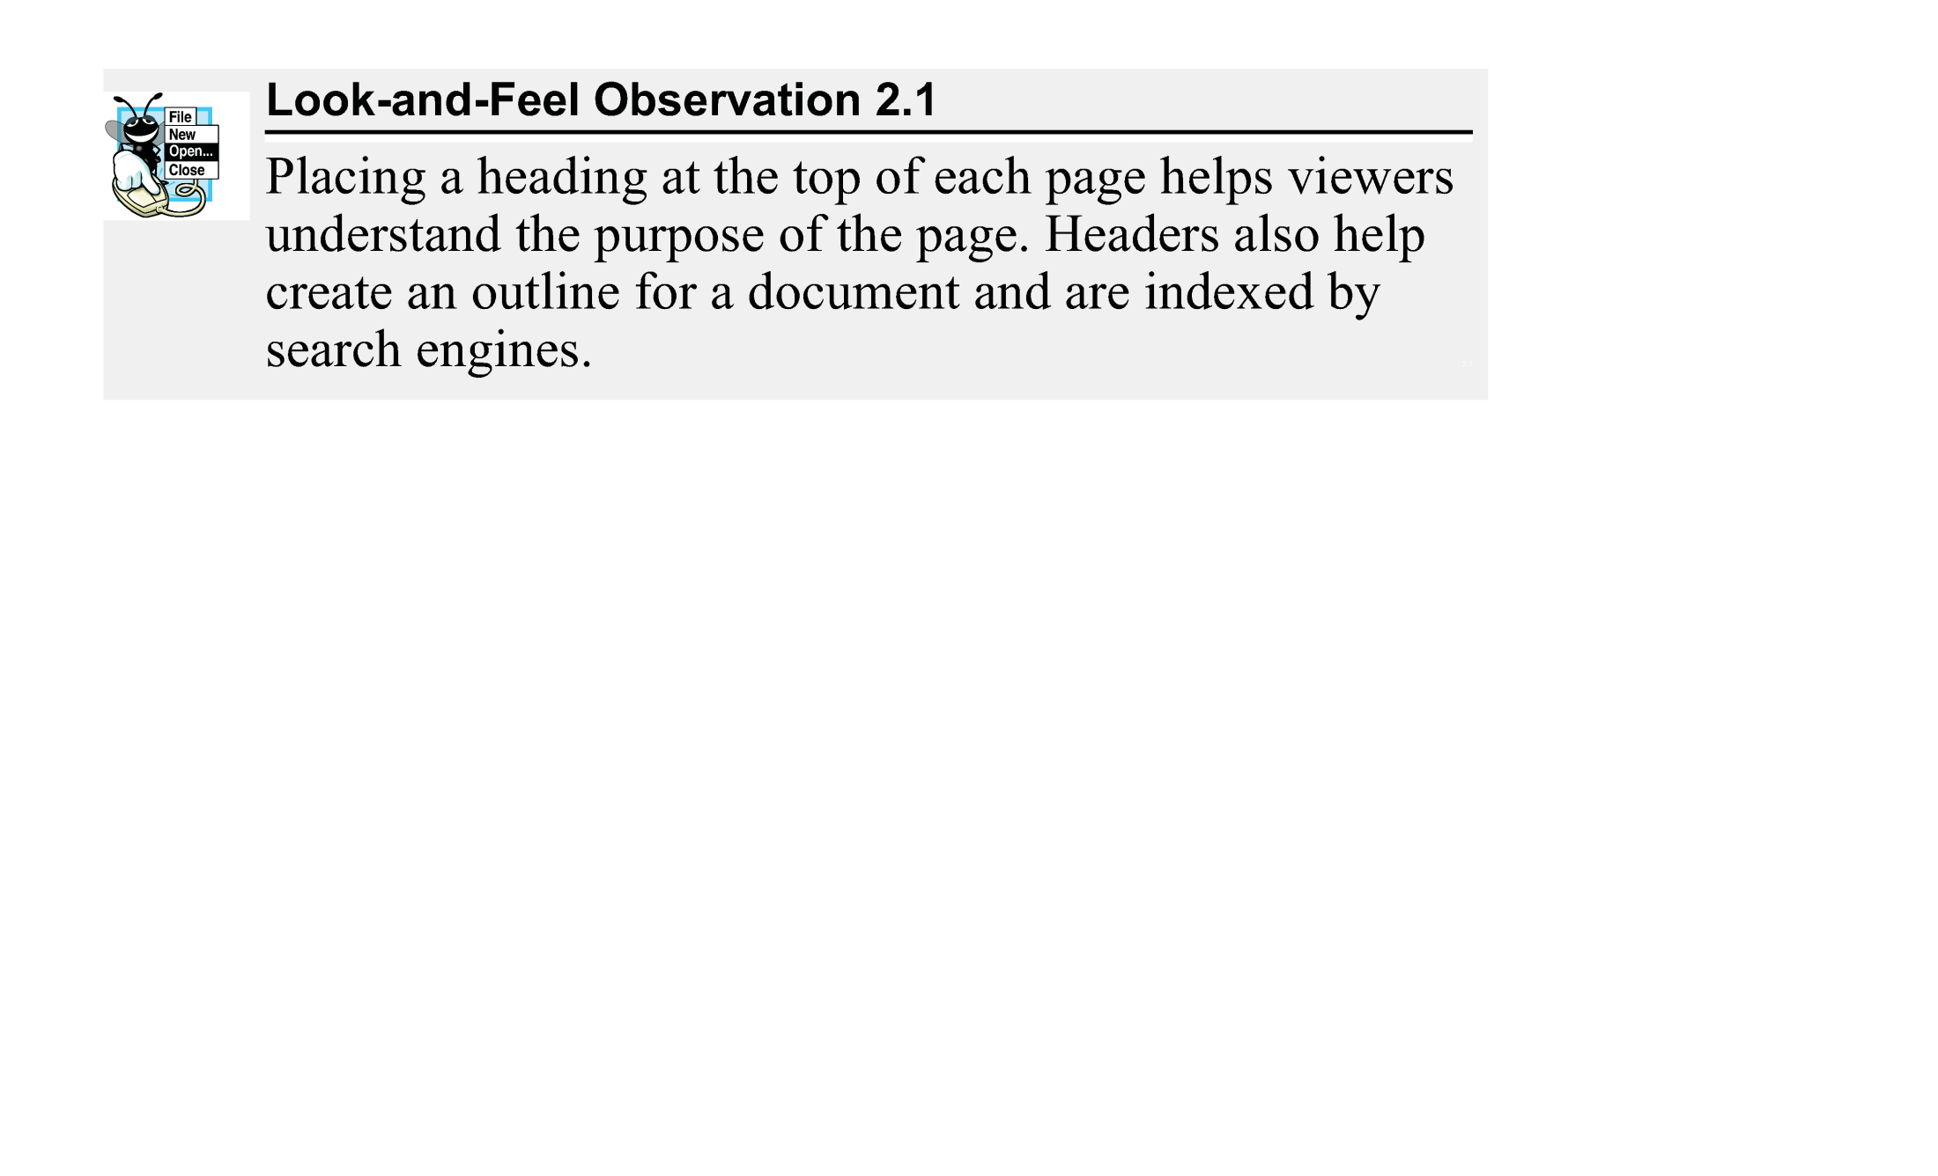

Slide 22
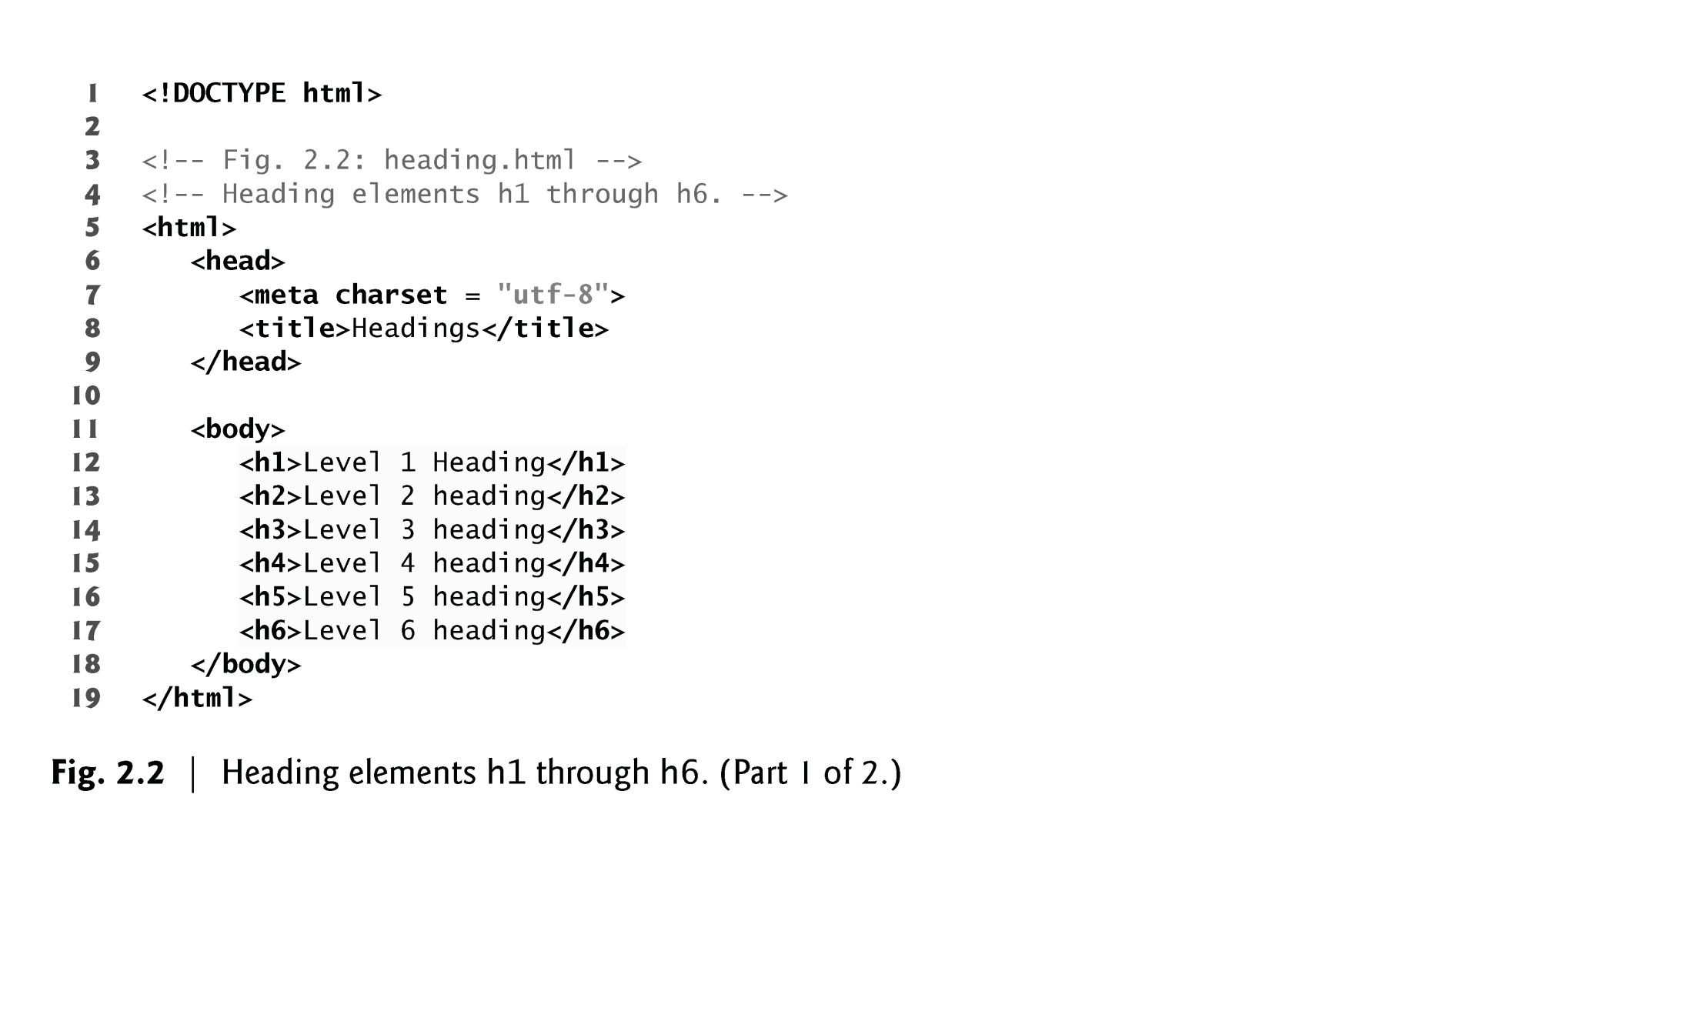

Slide 23
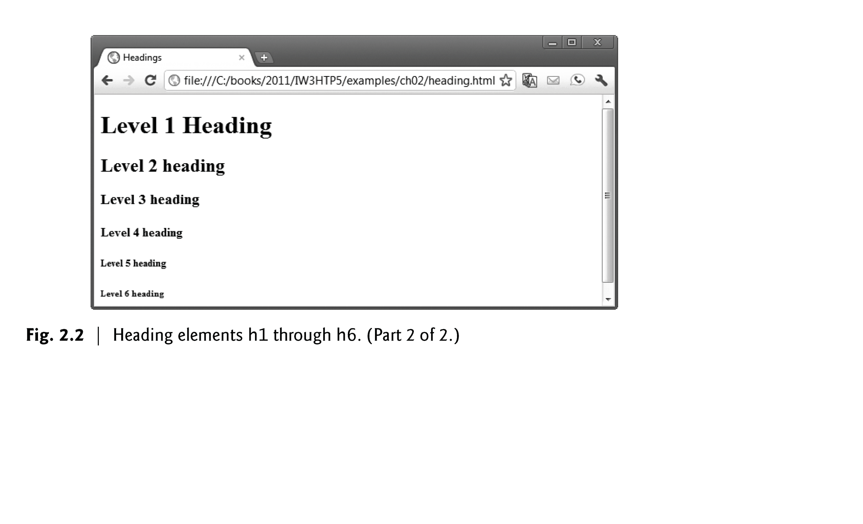

Slide 24
2.6 Linking
A hyperlink references or links to other resources, such as HTML5 documents and images.
Web browsers typically underline text hyperlinks and color them blue by default.

Slide 25
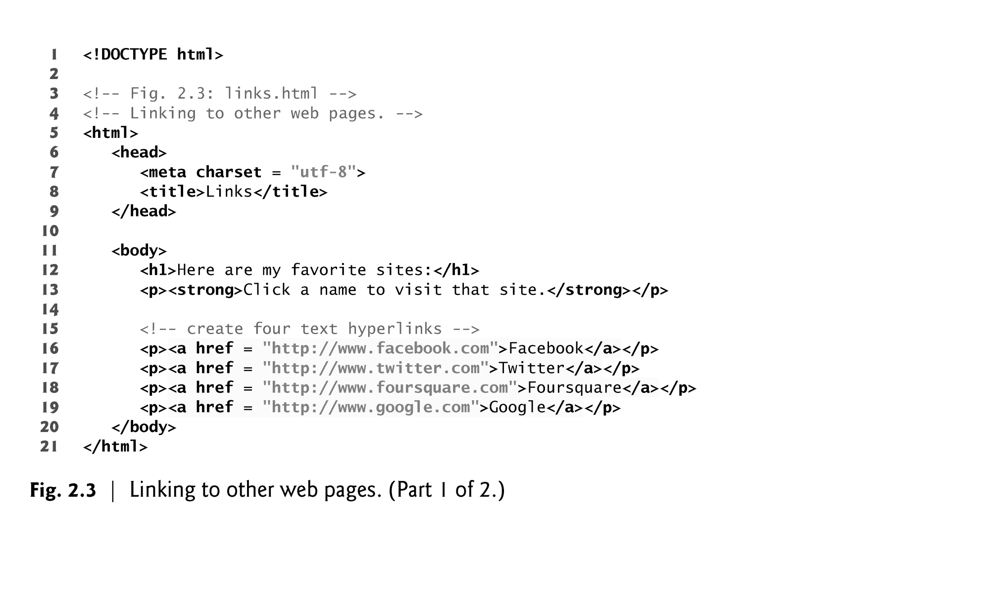

Slide 26
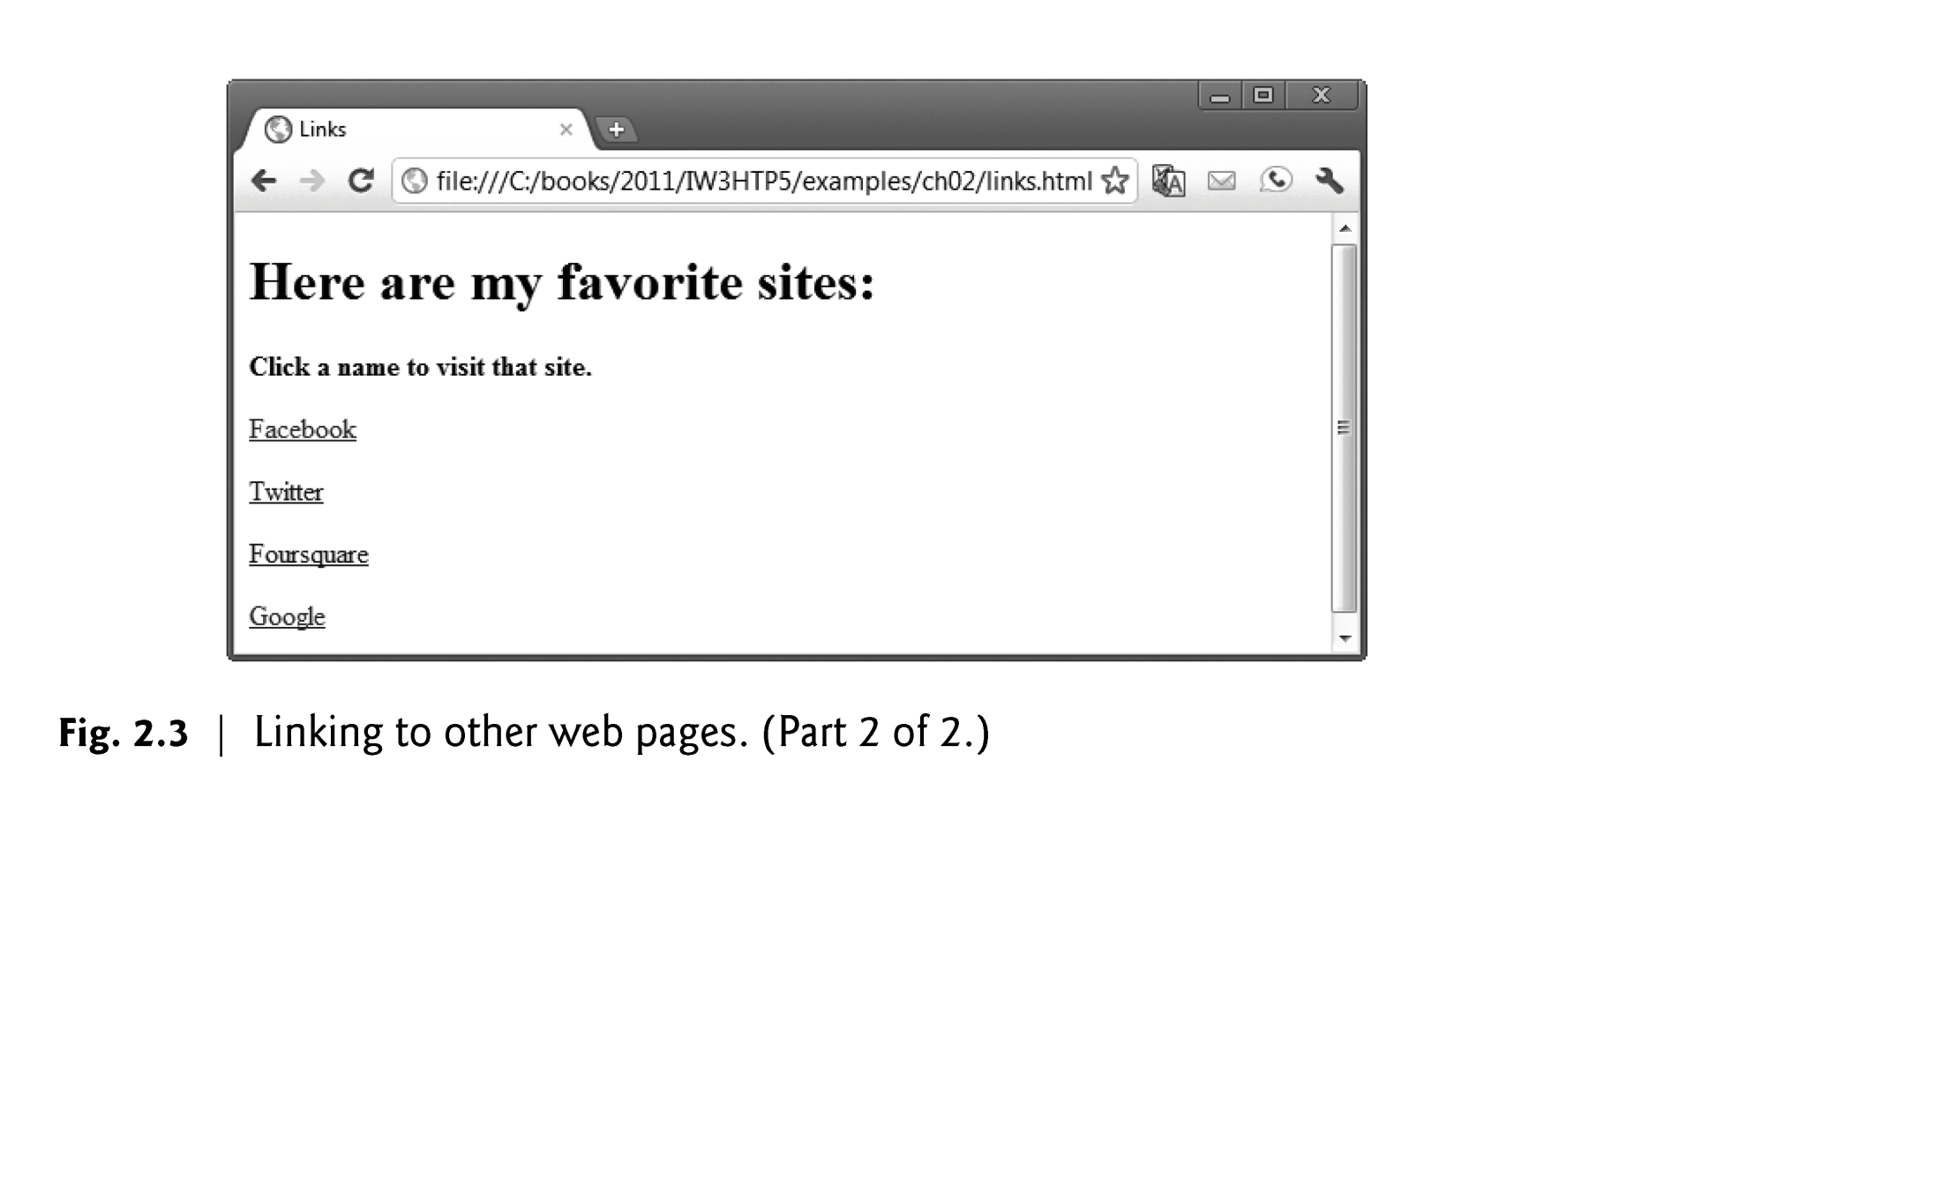

Slide 27
2.6 Linking (Cont.)
The strong element indicates that the content has high importance. Browsers typically render such text in a bold font.
Links are created using the a (anchor) element.
Attribute href (hypertext reference) specifies a resource’s location, such as
a web page or location within a web page
a file
an e-mail address
When a URL does not indicate a specific document on the website, the web server returns a default web page. This page is often called index.html, but most web servers can be configured to use any file as the default web page for the site.
If the web server cannot locate a requested document, it returns an error indication to the web browser (known as a 404 error), and the browser displays a web page containing an error message.

Slide 28
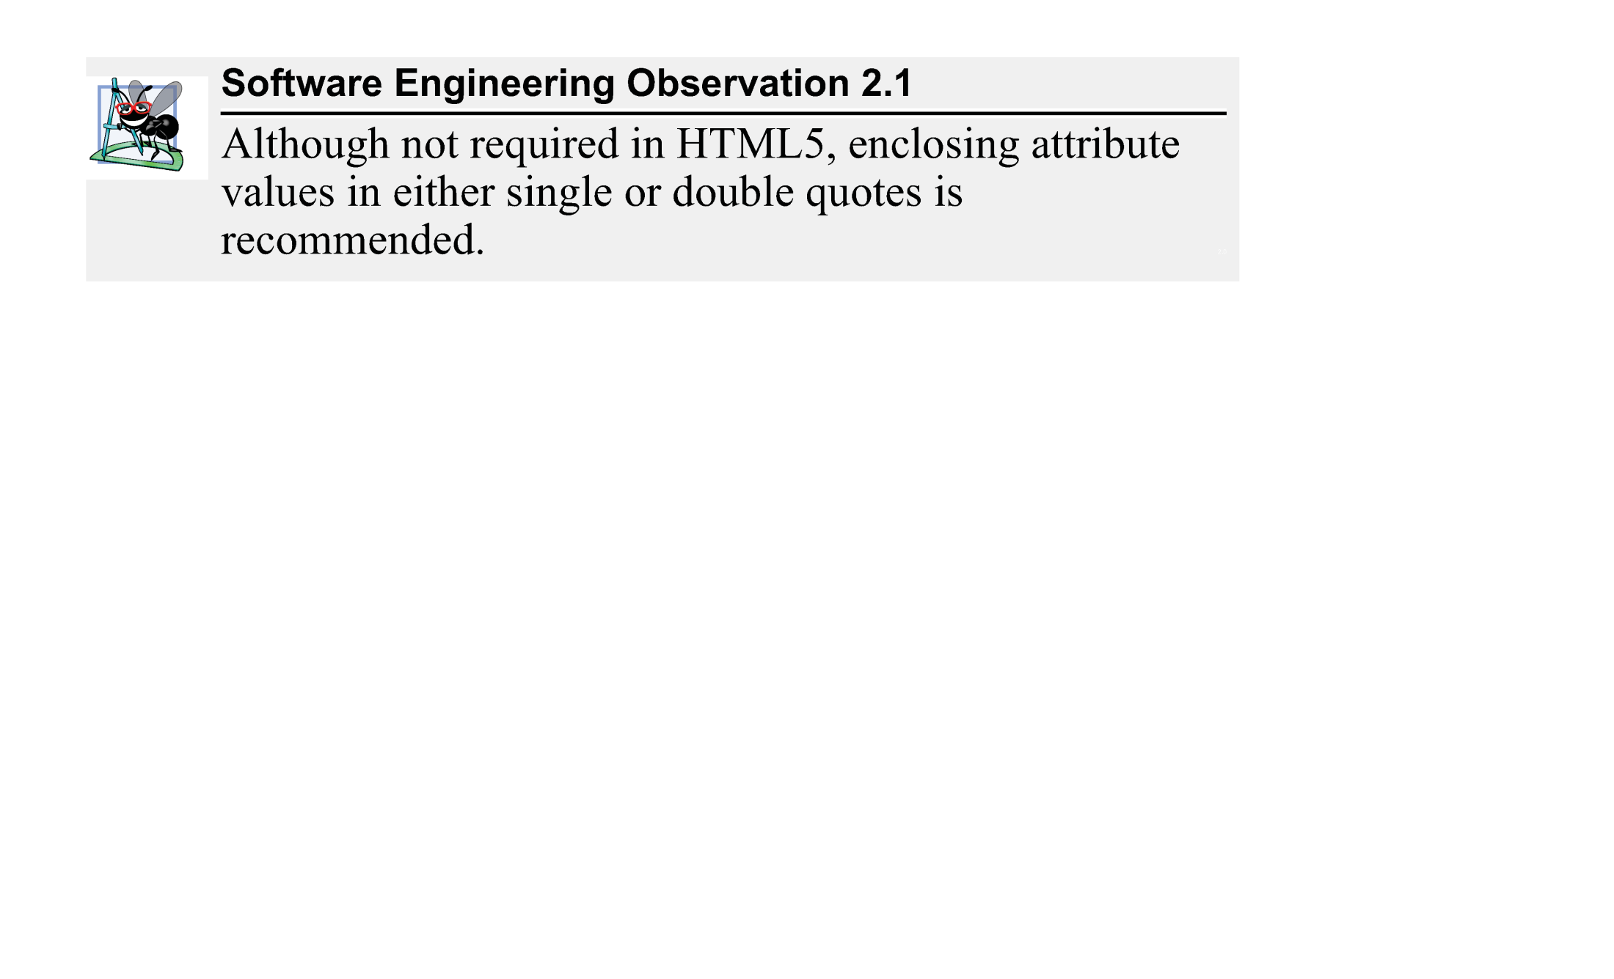

Slide 29
2.6 Linking (Cont.)
Hyperlinking to an E-Mail Address
Anchors can link to an e-mail address using a mailto: URL
When a user clicks this type of anchored link, most browsers launch the default e-mail program (e.g., Mozilla Thunderbird, Microsoft Outlook or Apple Mail) to enable the user to write an e-mail message to the linked address.

Slide 30
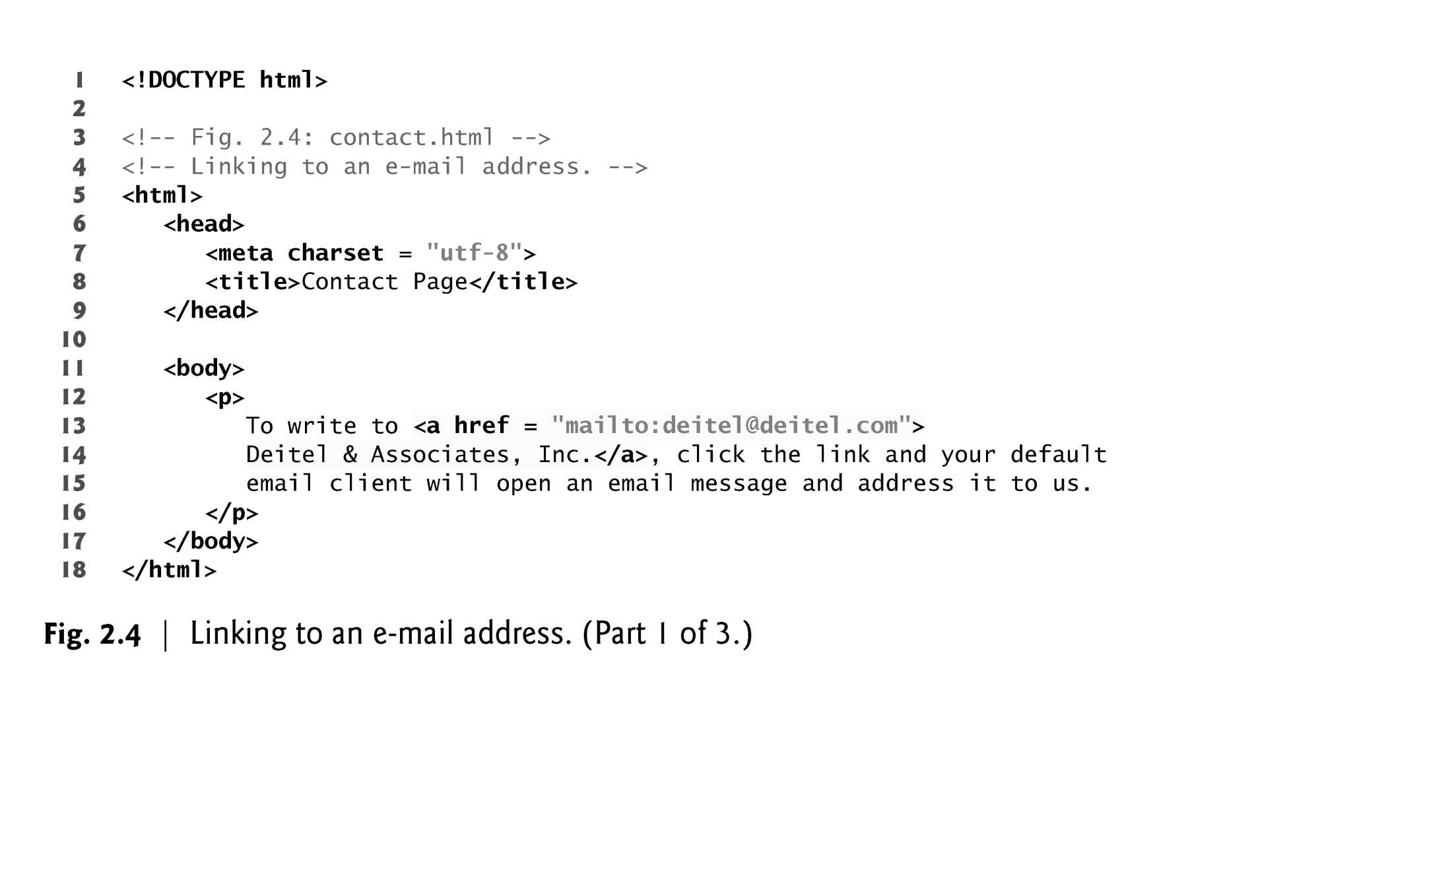

Slide 31
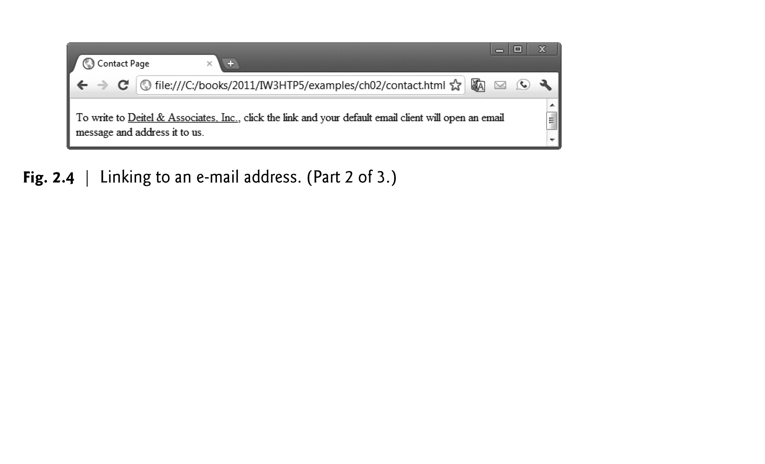

Slide 32
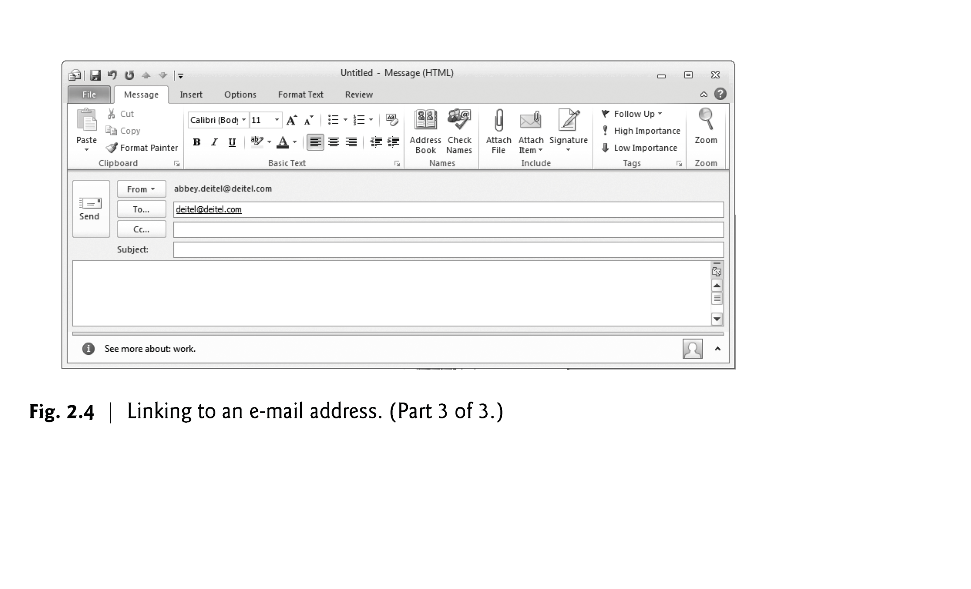

Slide 33
2.7 Images
The most popular image formats used by web developers today are PNG (Portable Network Graphics) and JPEG (Joint Photographic Experts Group).
Users can create images using specialized software, such as Adobe Photoshop Express (www.photoshop.com), G.I.M.P. (www.gimp.org), Inkscape (www.inkscape.org) and many more.
Images may also be acquired from various websites, many of which offer royalty-free images.

Slide 34
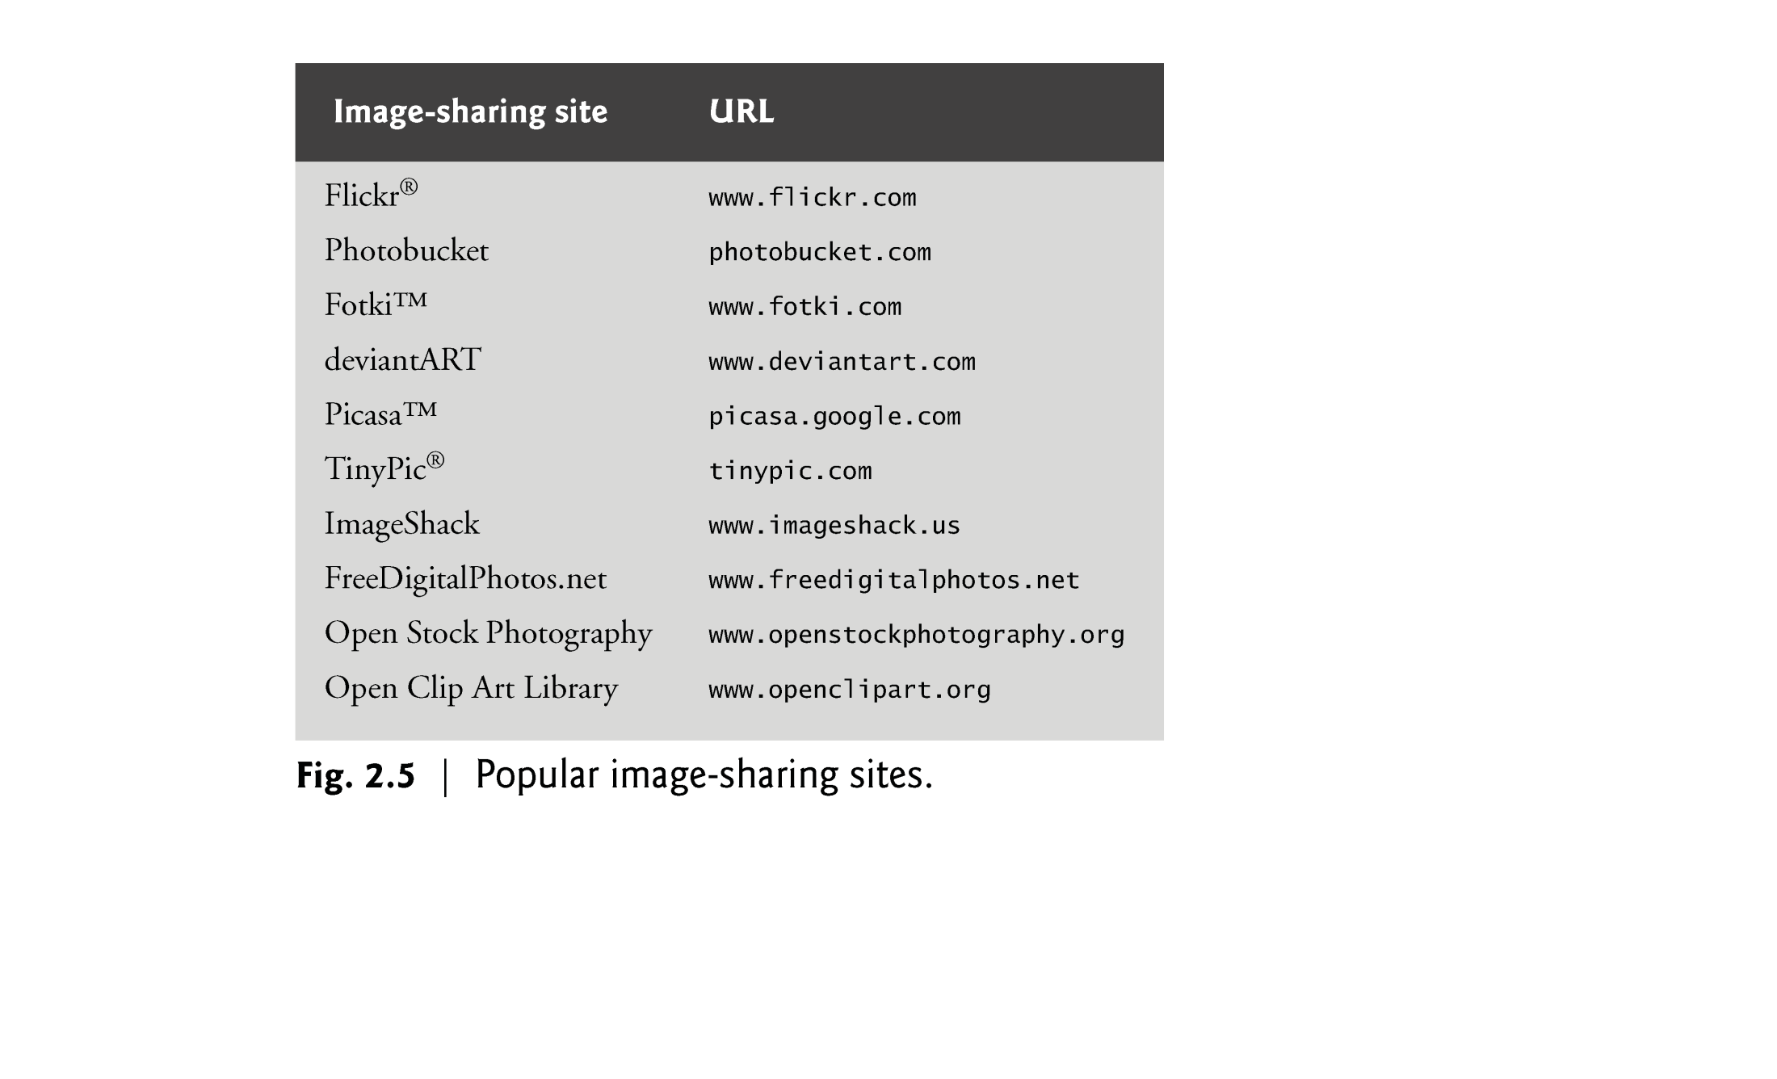

Slide 35
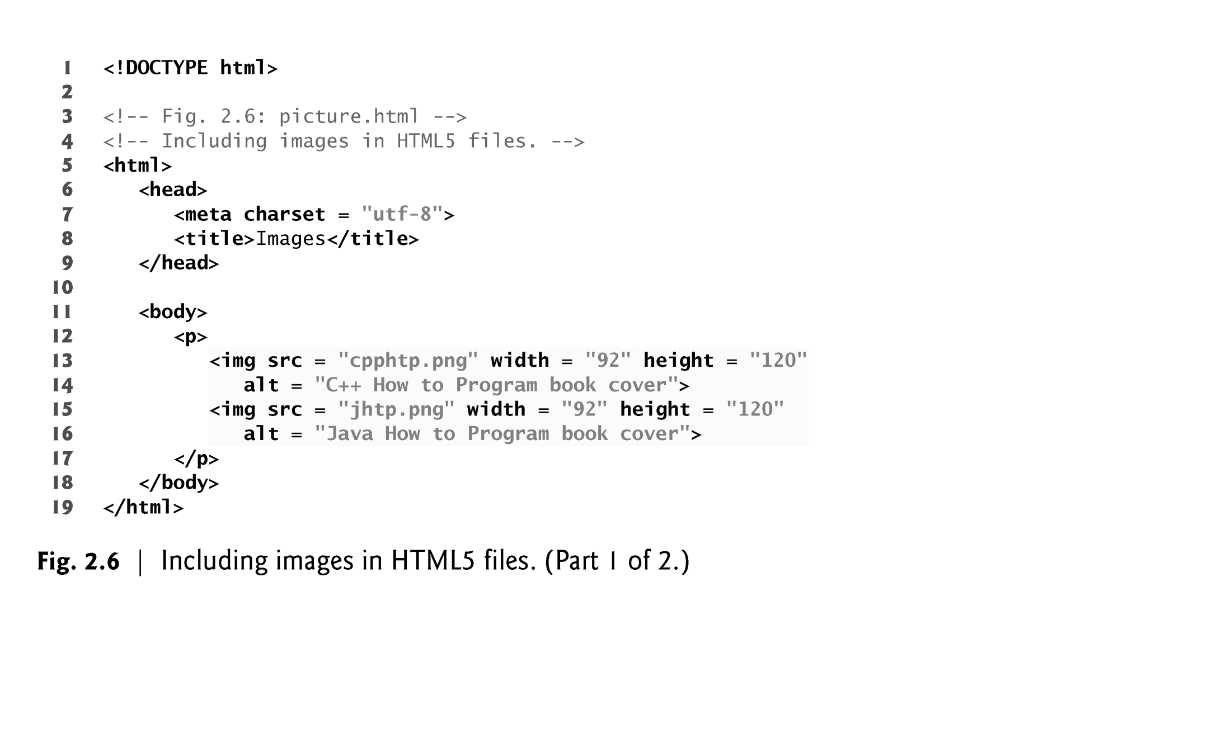

Slide 36
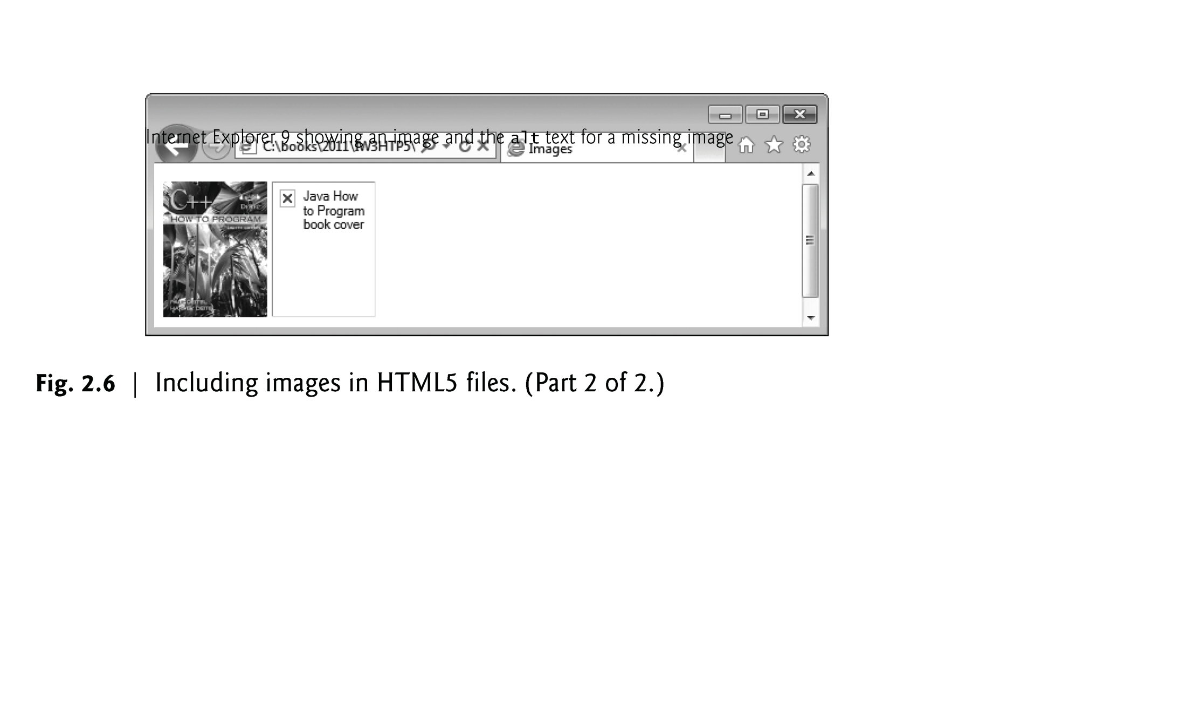

Slide 37
2.7 Images (cont.)
The img element’s src attribute specifies an image’s location
Every img element must have an alt attribute, which contains text that is displayed if the client cannot render the image
The alt attribute makes web pages more accessible to users with disabilities, especially vision impairments
Width and height are optional attributes
If omitted, the browser uses the image’s actual width and height
Images are measured in pixels

Slide 38
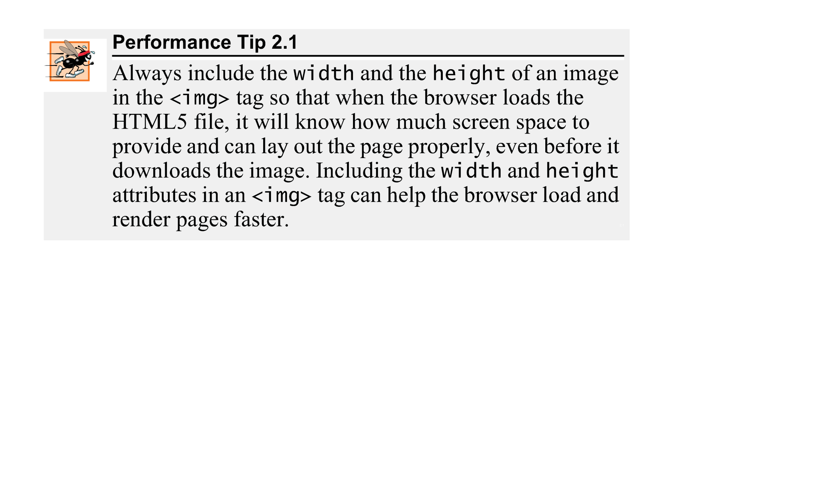

Slide 39
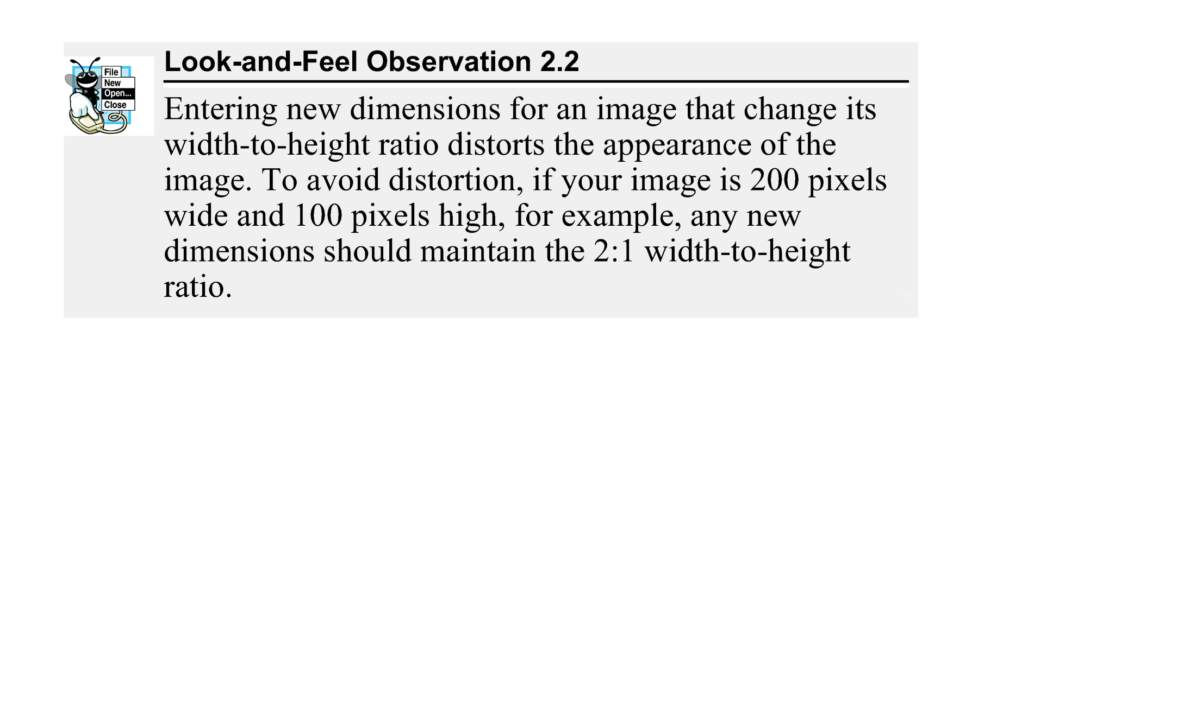

Slide 40
2.7 Images (Cont.)
alt Attribute
A browser may not be able to render an image.
Every img element in an HTML5 document must have an alt attribute.
If a browser cannot render an image, the browser displays the alt attribute’s value.
The alt attribute is also important for accessibility—speech synthesizer software can speak the alt attribute’s value so that a visually impaired user can understand what the browser is displaying. For this reason, the alt attribute should describe the image’s contents.

Slide 41
2.7 Images (Cont.)
Void Elements
Some HTML5 elements (called void elements) contain only attributes and do not mark up text (i.e., text is not placed between a start and an end tag).
You can terminate void elements (such as the img element) by using the forward slash character (/) inside the closing right angle bracket (>) of the start tag.
For example, lines 15–16 of Fig. 2.6 could be written as follows:
<img src = "jhtp.png" width = "92" height = "120"
alt = "Java How to Program book cover" />

Slide 42
2.7 Images (Cont.)
Using Images as Hyperlinks
By using images as hyperlinks, you can create graphical web pages that link to other resources.
In Fig. 2.7, we create five different image hyperlinks.
Clicking an image in this example takes the user to a corresponding web page—one of the other examples in this chapter.

Slide 43
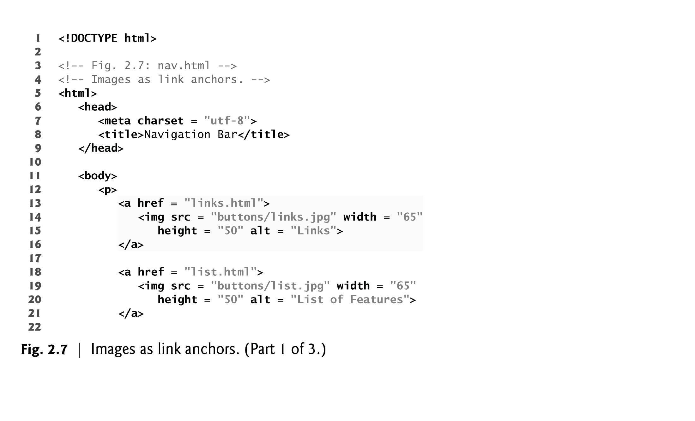

Slide 44
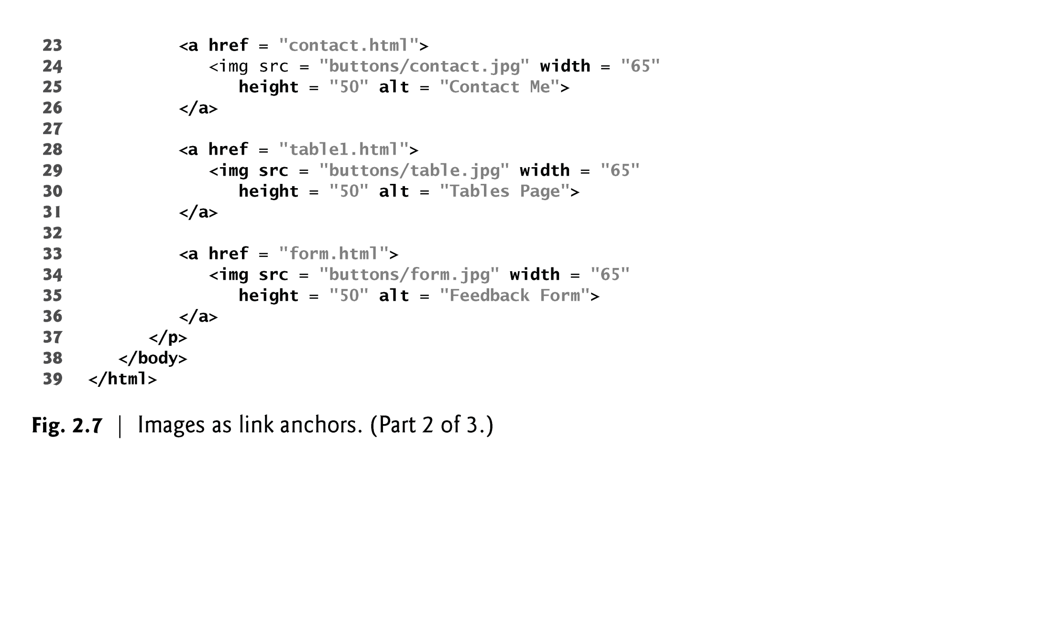

Slide 45
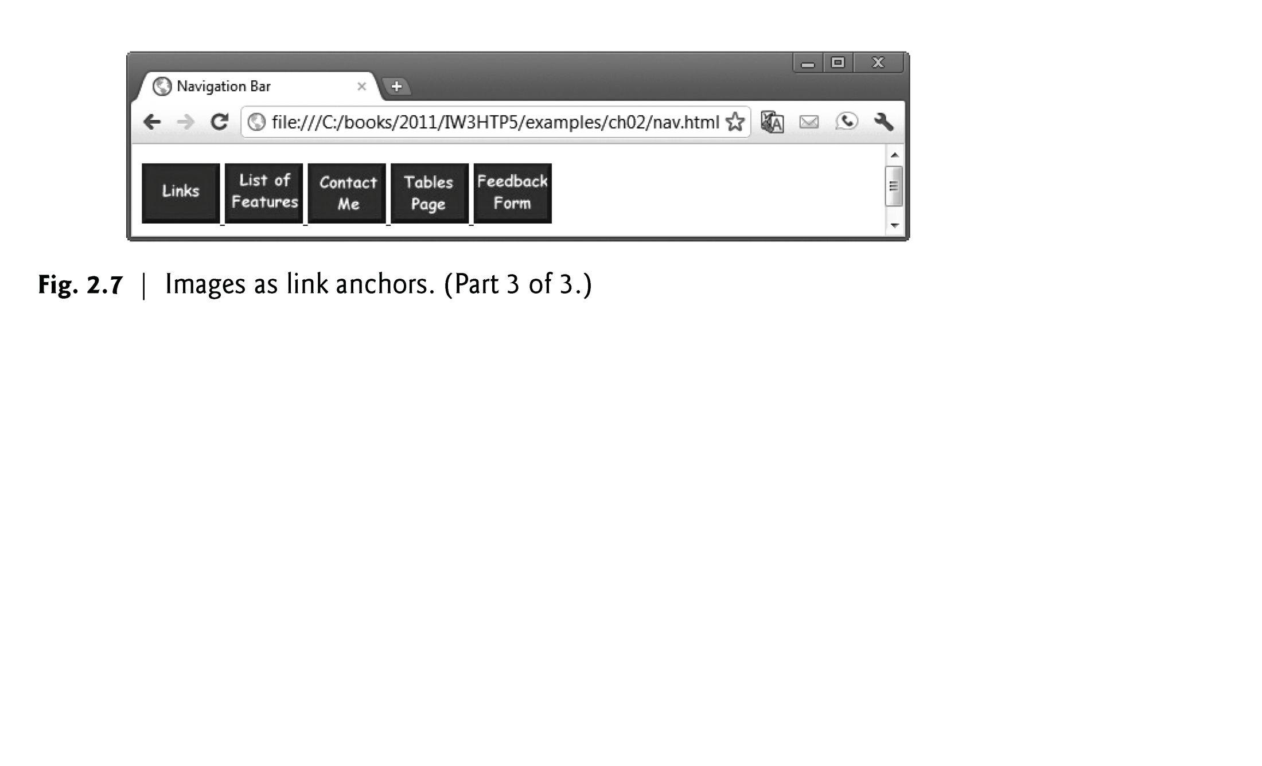

Slide 46
2.8 Special Characters and Horizontal Rules
HTML5 provides character entity references (in the form &code;) for representing special characters that cannot be rendered otherwise
The code can be:
Word abbreviations
Numbers
Decimal
Hexadecimal

Slide 47
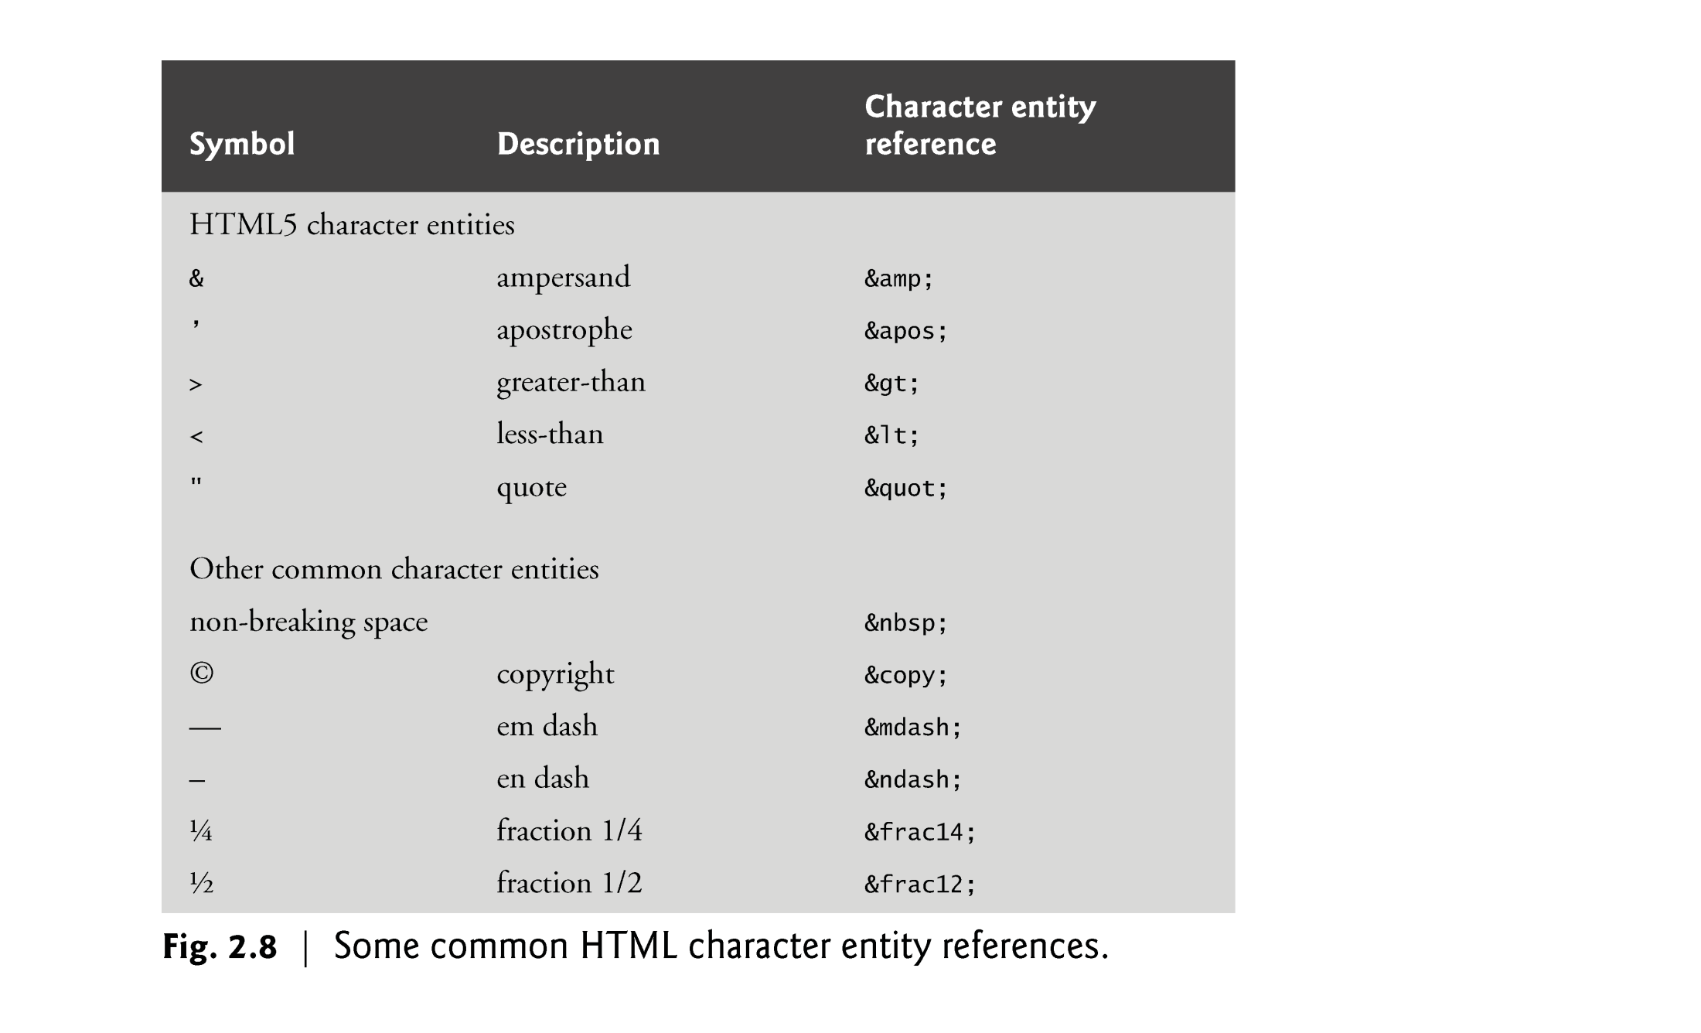

Slide 48
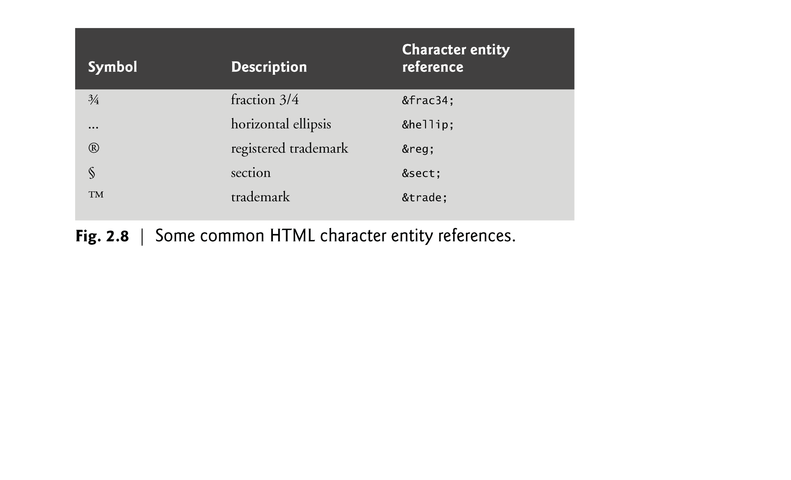

Slide 49
2.8 Special Characters and Horizontal Rules (Cont.)
Figure 2.9 demonstrates how to use special characters in an HTML5 document.
For an extensive list of character entities, see
www.w3.org/TR/REC-html40/sgml/entities.html

Slide 50
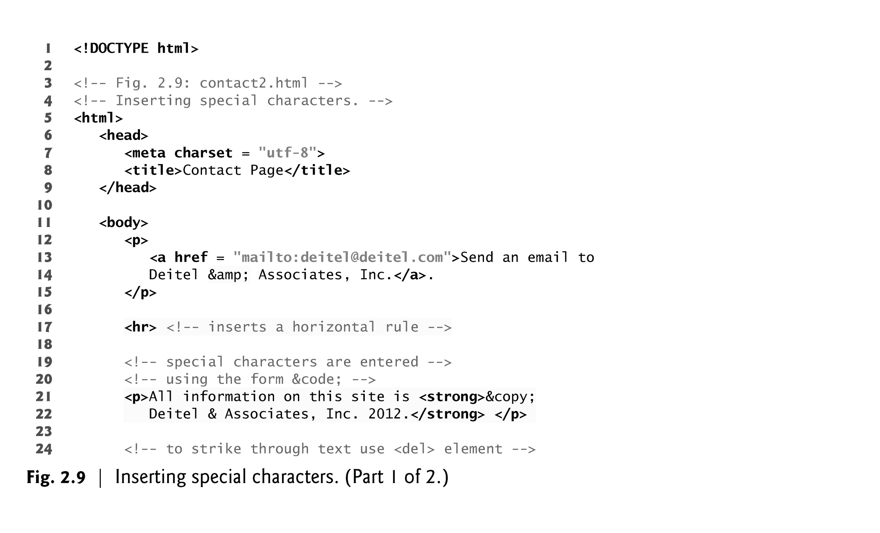

Slide 51
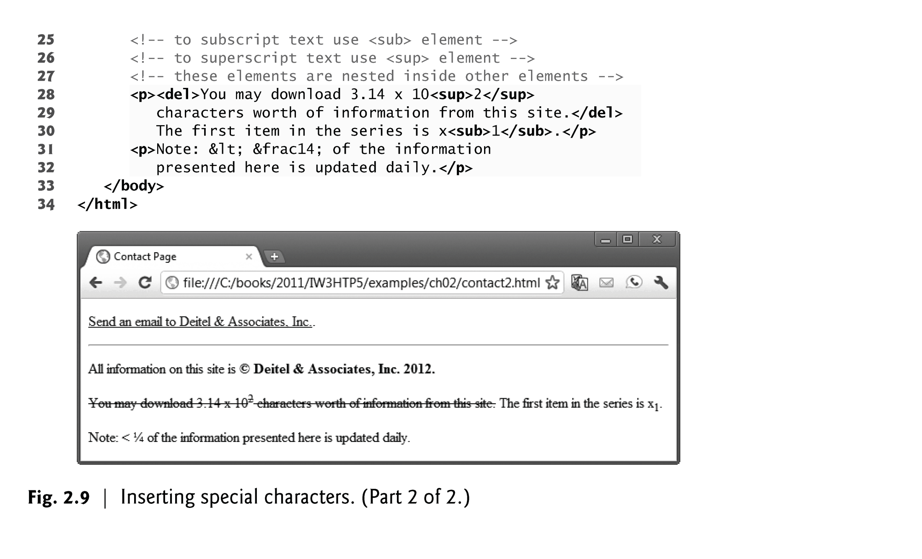

Slide 52
2.8 Special Characters and Horizontal Rules (Cont.)
A horizontal rule, indicated by the <hr> tag renders a horizontal line with extra space above and below it in most browsers.
The horizontal rule element should be considered a legacy element and you should avoid using it.
CSS can be used to add horizontal rules and other formatting to documents.
Special characters can also be represented as numeric character references—decimal or hexadecimal (hex) values representing special characters.
For example, the & character is represented in decimal and hexadecimal notation as &#38; and &#x26;, respectively.
Hexadecimal numbers are discussed in Appendix E, Number Systems, which is available online at www.deitel.com/books/iw3htp5/.

Slide 53
2.9 Lists
Unordered list element ul
creates a list in which each item in the list begins with a bullet symbol (typically a disc)
Each entry is an li (list item) element. Most web browsers render these elements with a line break and a bullet symbol at the beginning of the line.

Slide 54
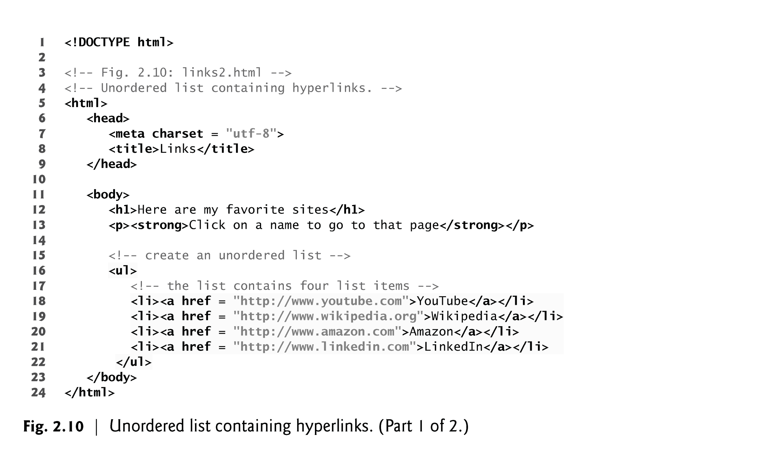

Slide 55
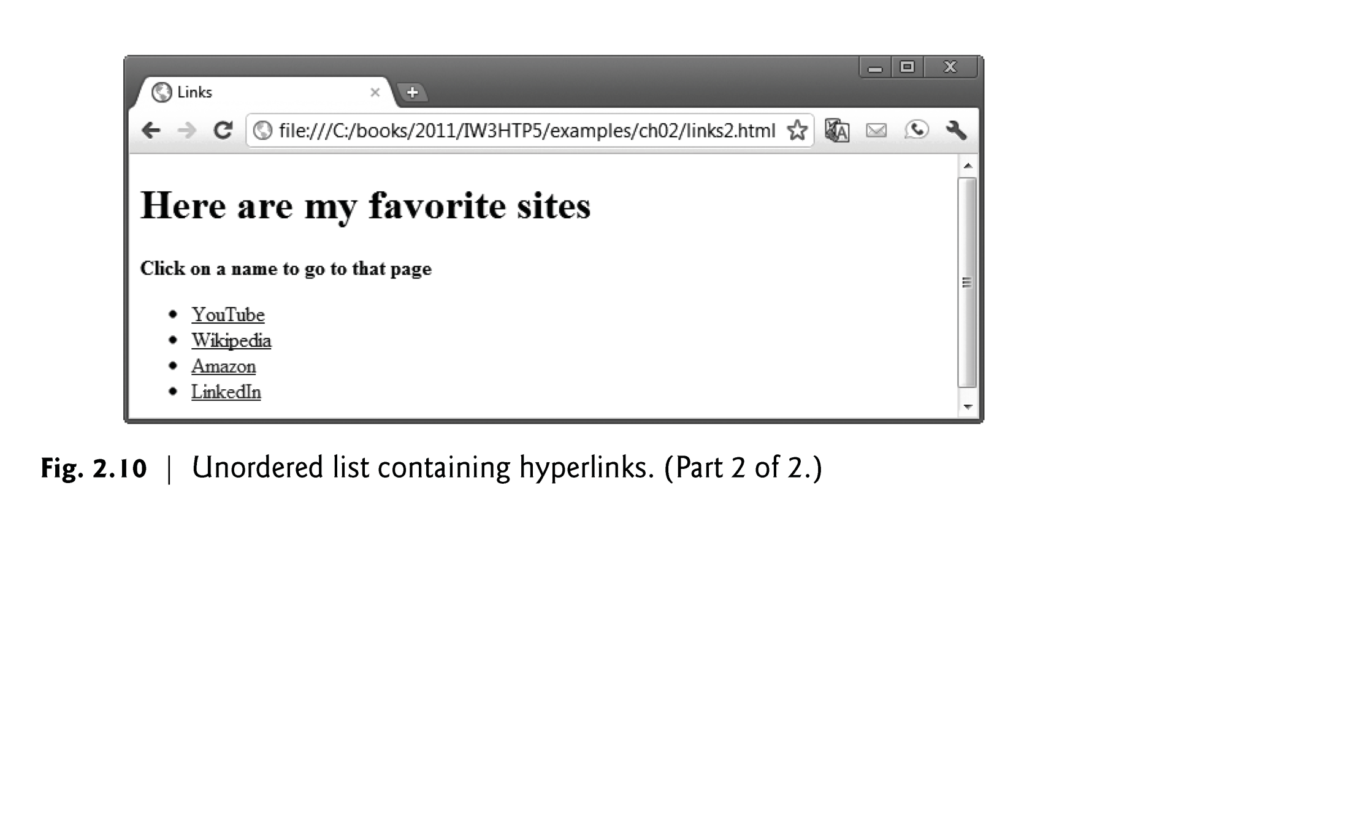

Slide 56
2.9 Lists (Cont.)
Nested Lists
Lists may be nested to represent hierarchical relationships, as in a multi-level outline.
Figure 2.11 demonstrates nested lists and ordered lists.
The ordered-list element ol creates a list in which each item begins with a number.

Slide 57
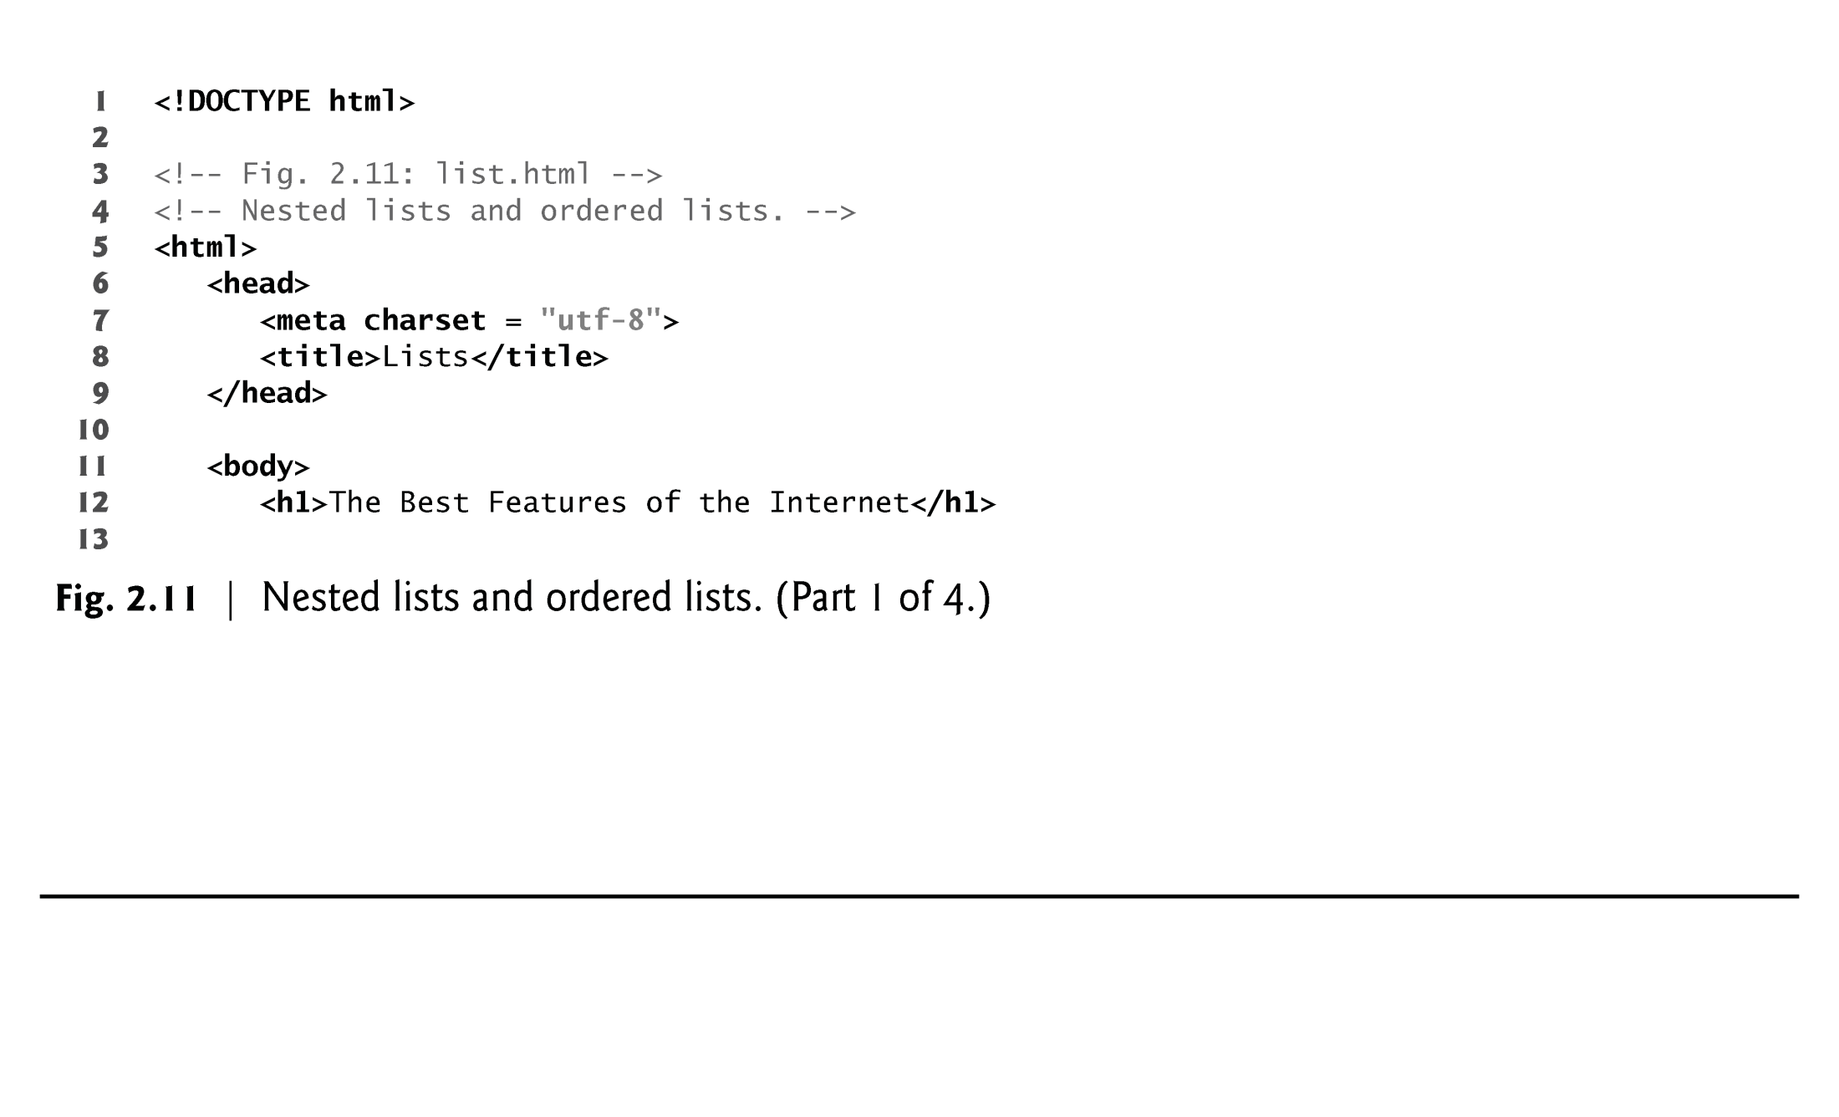

Slide 58
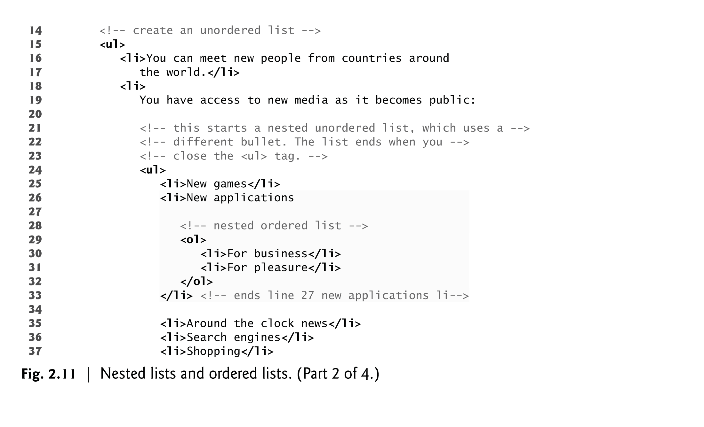

Slide 59
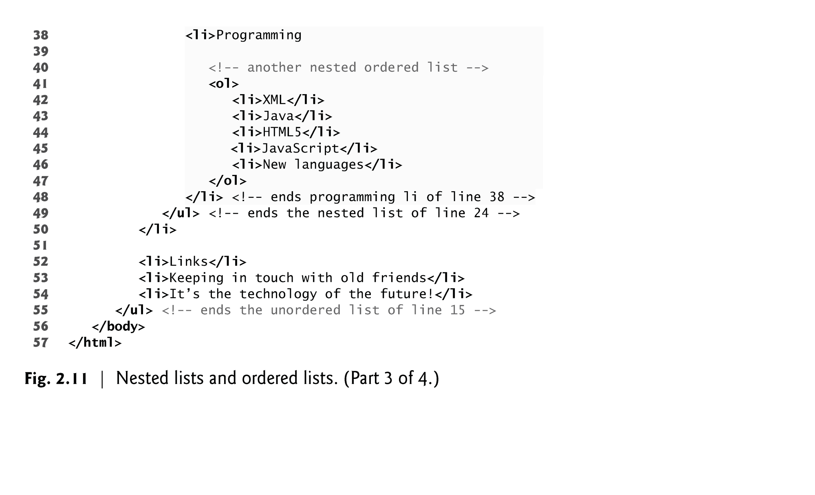

Slide 60
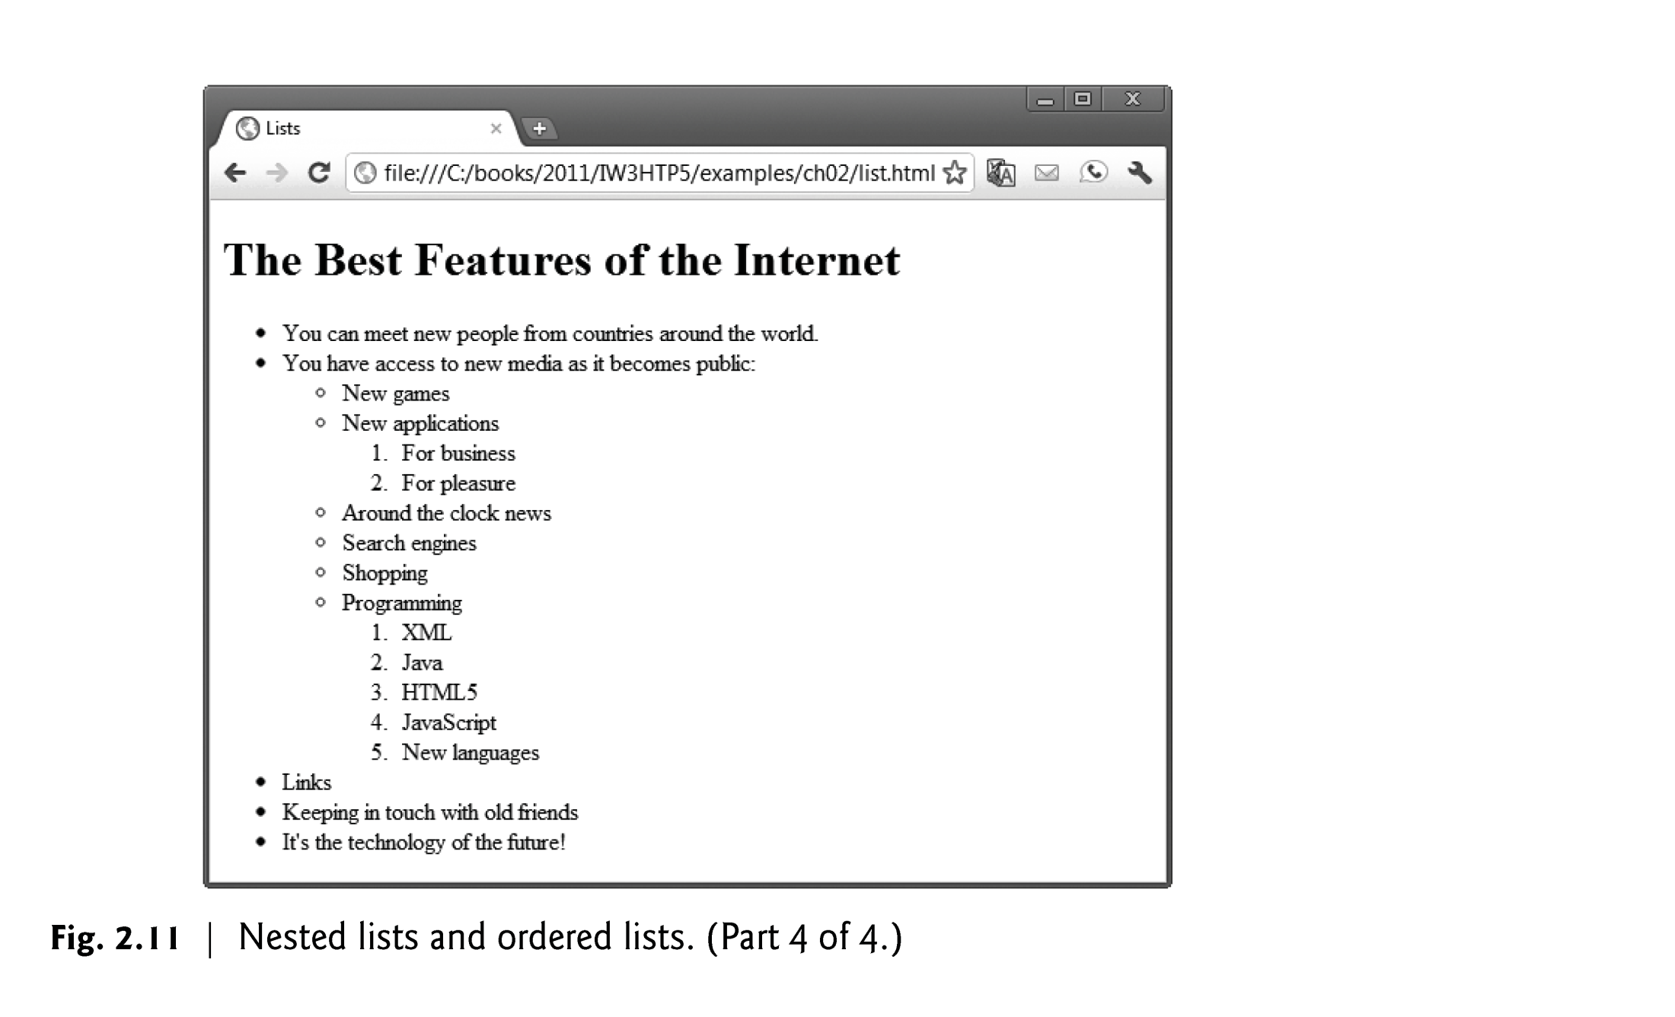

Slide 61
Descrition Lists (Cont.)
The <dl> tag defines a description list.
The <dl> tag is used in conjunction with <dt> (defines terms/names) and <dd> (describes each term/name
<dl> <dt>Coffee</dt> <dd>- black hot drink</dd> <dt>Milk</dt> <dd>- white cold drink</dd> </dl>

Slide 62
2.10 Tables
Tables are frequently used to organize data into rows and columns.
The table element defines an HTML5 table
The summary attribute summarizes the table’s contents and is used by speech devices to make the table more accessible to users with visual impairments.
The caption element specifies a table’s title.
It’s good practice to include a general description of a table’s information in the table element’s summary attribute—one of the many HTML5 features that make web pages more accessible to users with disabilities.
Speech devices use this attribute to make the table more accessible to users with visual impairments.

Slide 63
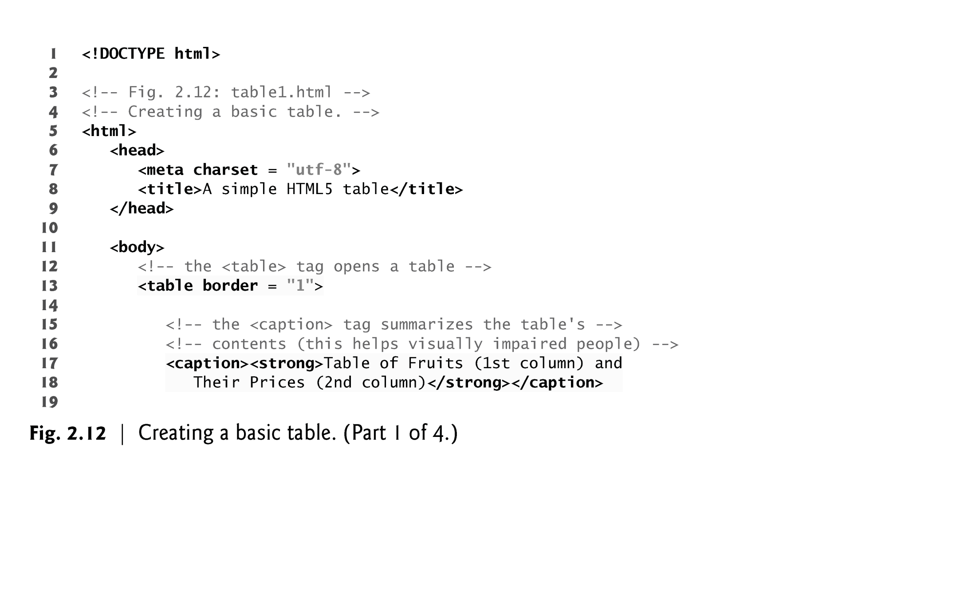

Slide 64
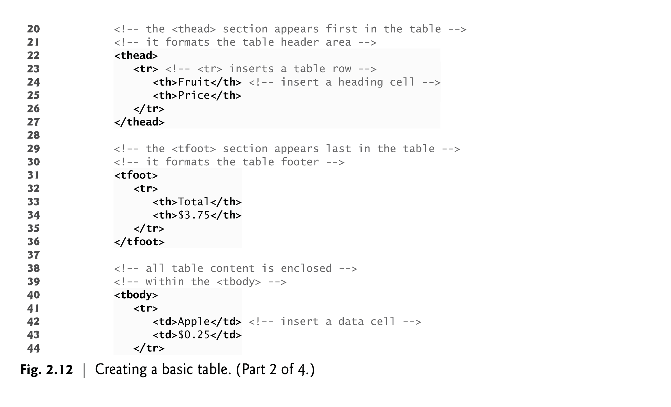

Slide 65
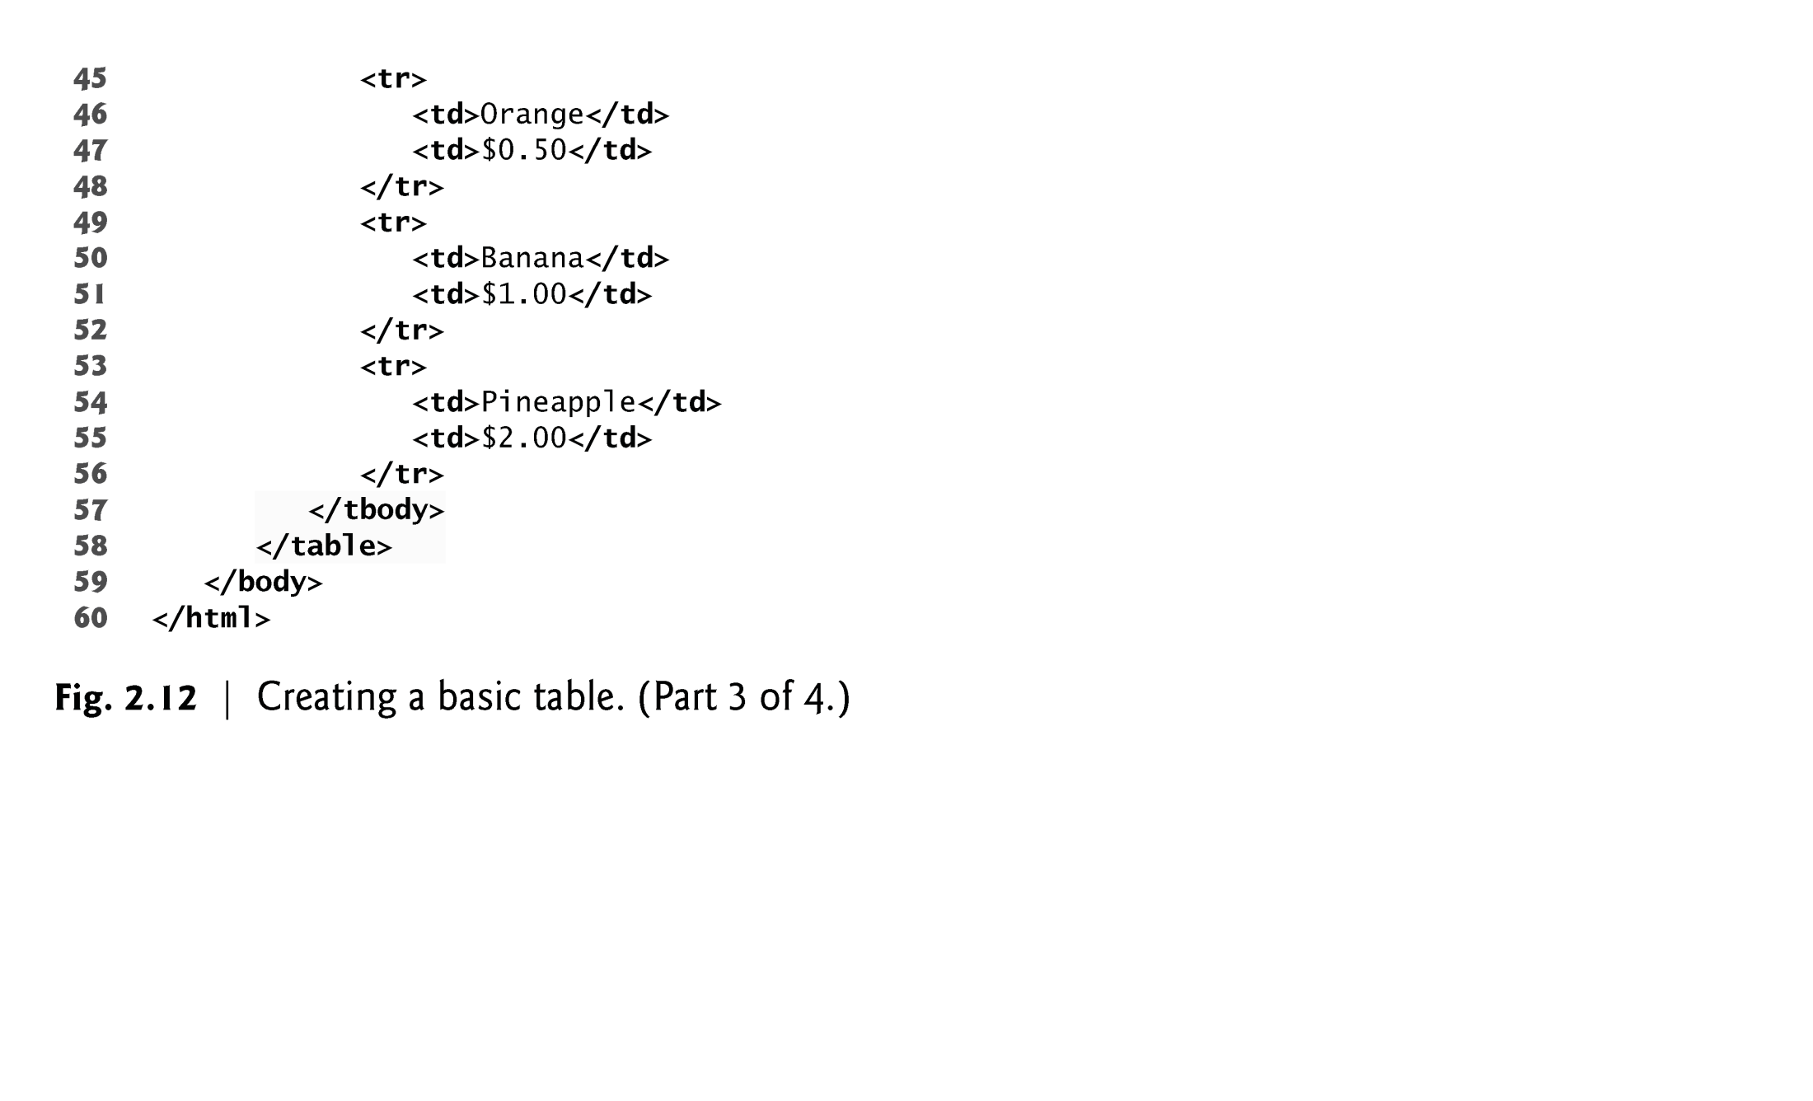

Slide 66
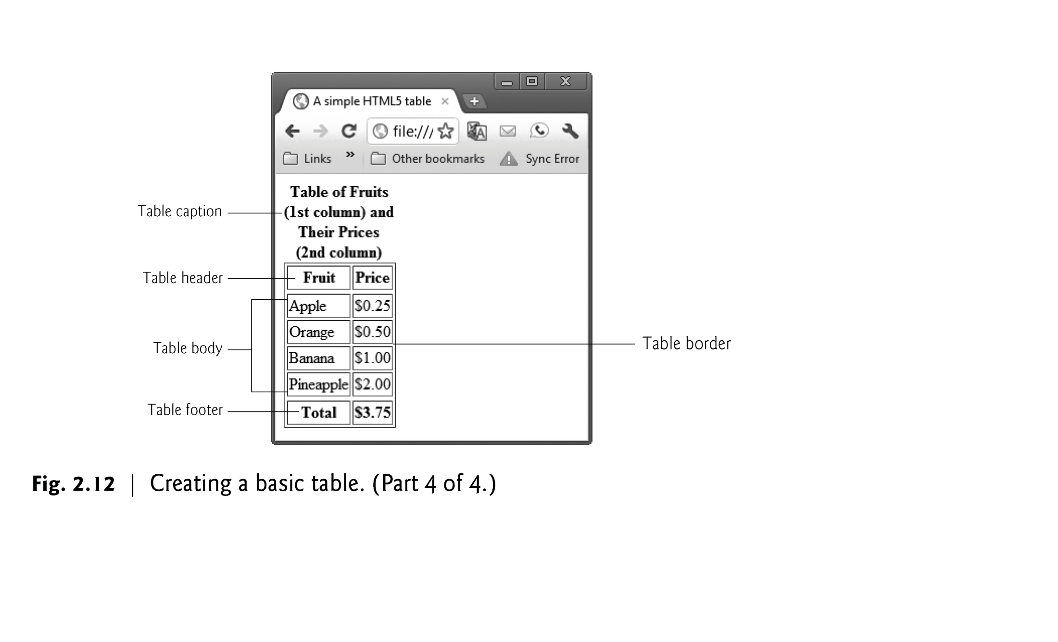

Slide 67
2.10 Tables (Cont.)
A table can be split into three distinct sections:
Head (thead element)
Table titles
Column headers
Body (tbody element)
Primary table data
Table Foot (tfoot element)
Calculation results
Footnotes
Above body section in the code, but displays at the bottom in the page

Slide 68
2.10 Tables (Cont.)
tr Element
Defines individual table rows
Element th
Defines a header cell
Td Element
Contains table data elements

Slide 69
2.10 Tables (Cont.)
Using rowspan and colspan with Tables
Figure 2.13 introduces two new attributes that allow you to build more complex tables.
You can merge data cells with the rowspan and colspan attributes
The values of these attributes specify the number of rows or columns occupied by the cell.
Can be placed inside any data cell or table header cell.
The br element is render as a line break in most browsers—any markup or text following a br element is rendered on the next line.
Like the img element, br is an example of a void element.
Like the hr element, br is considered a legacy formatting element that you should avoid using—in general, formatting should be specified using CSS.

Slide 70
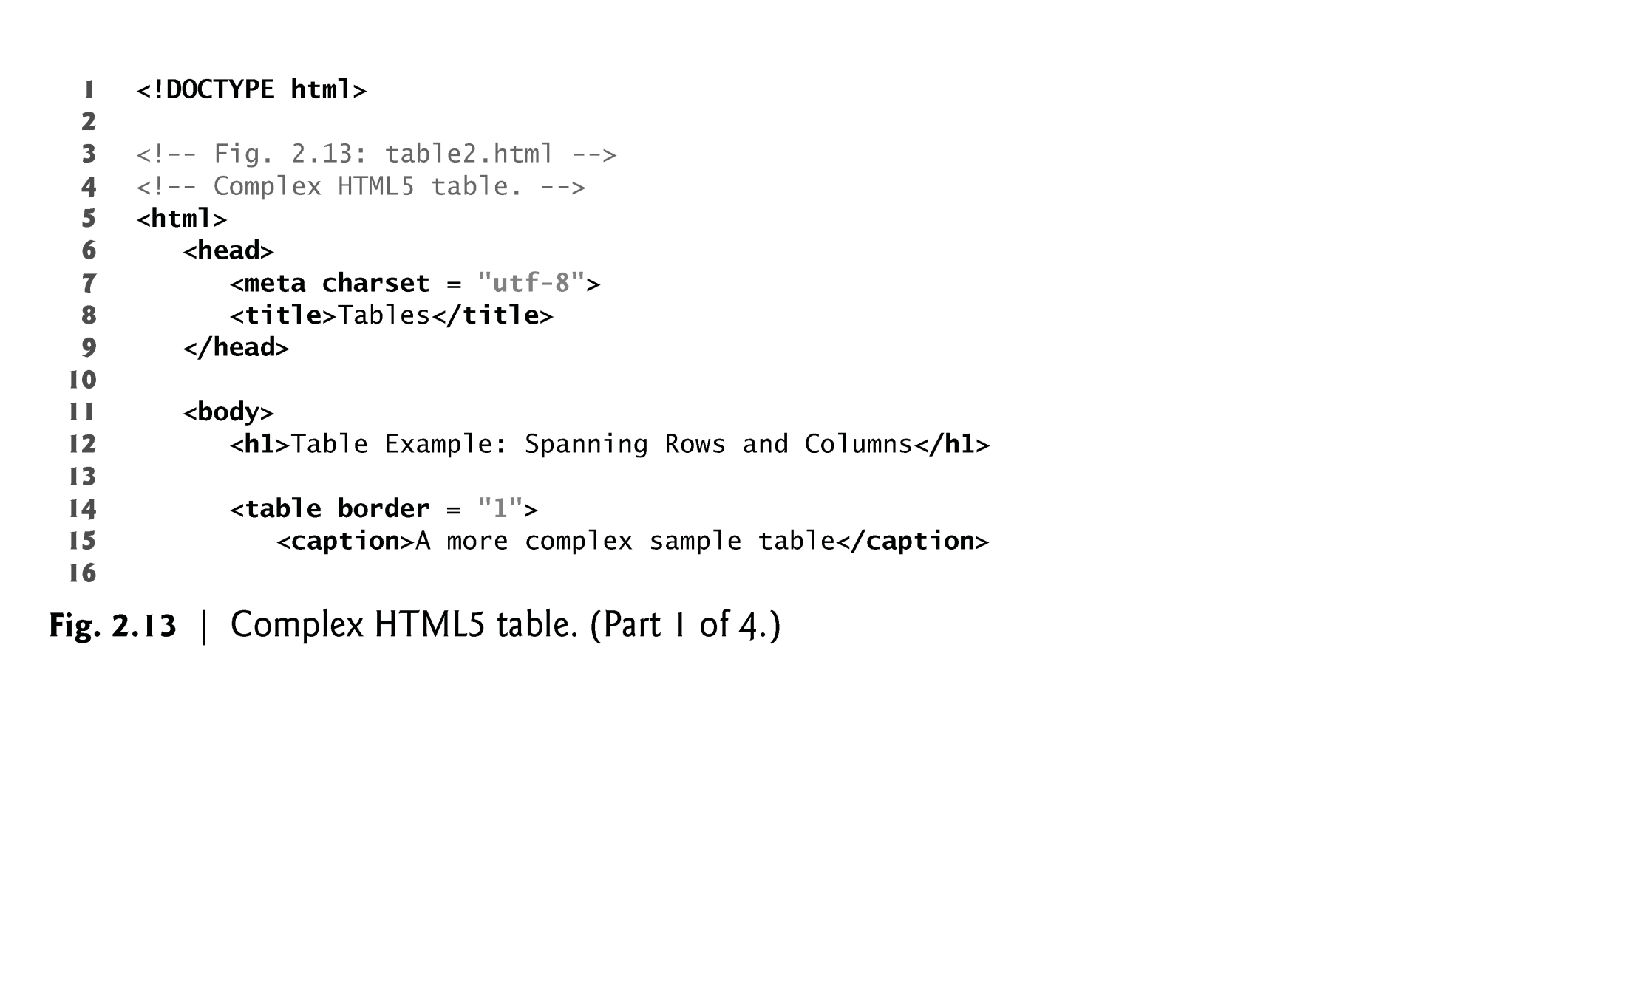

Slide 71
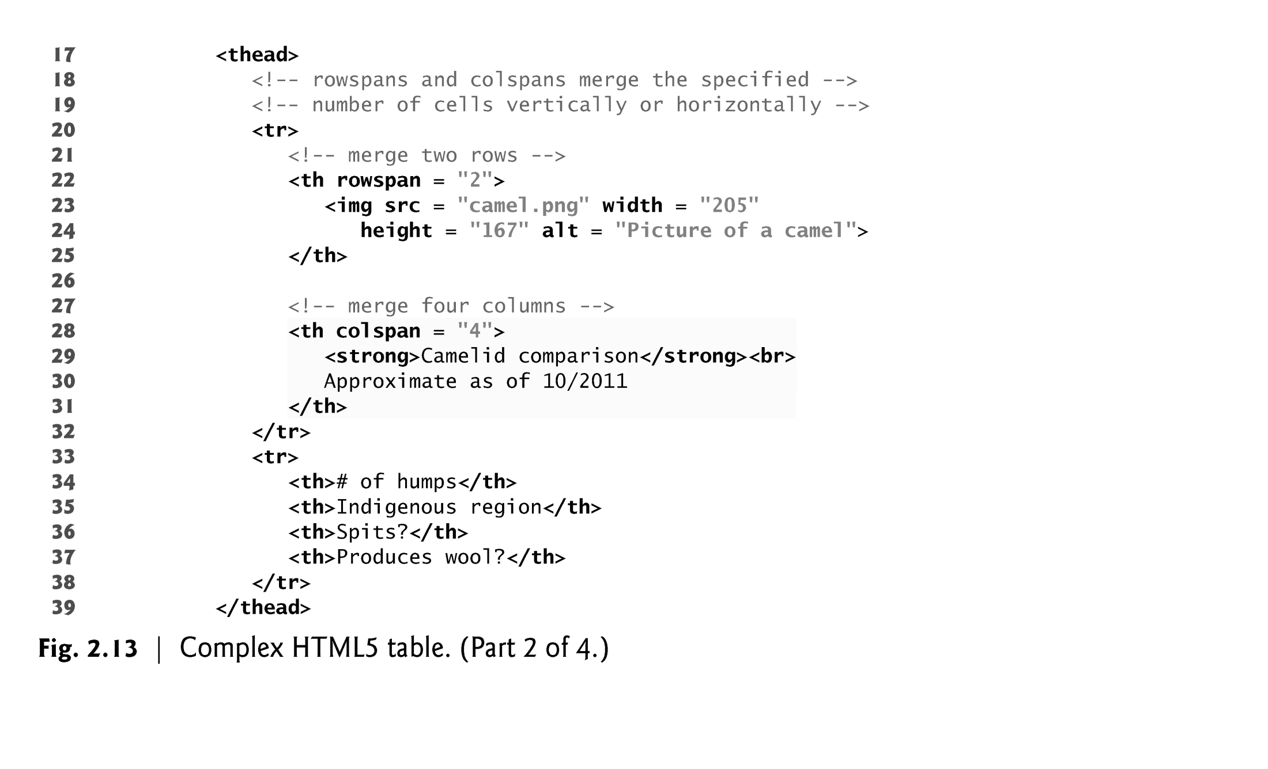

Slide 72
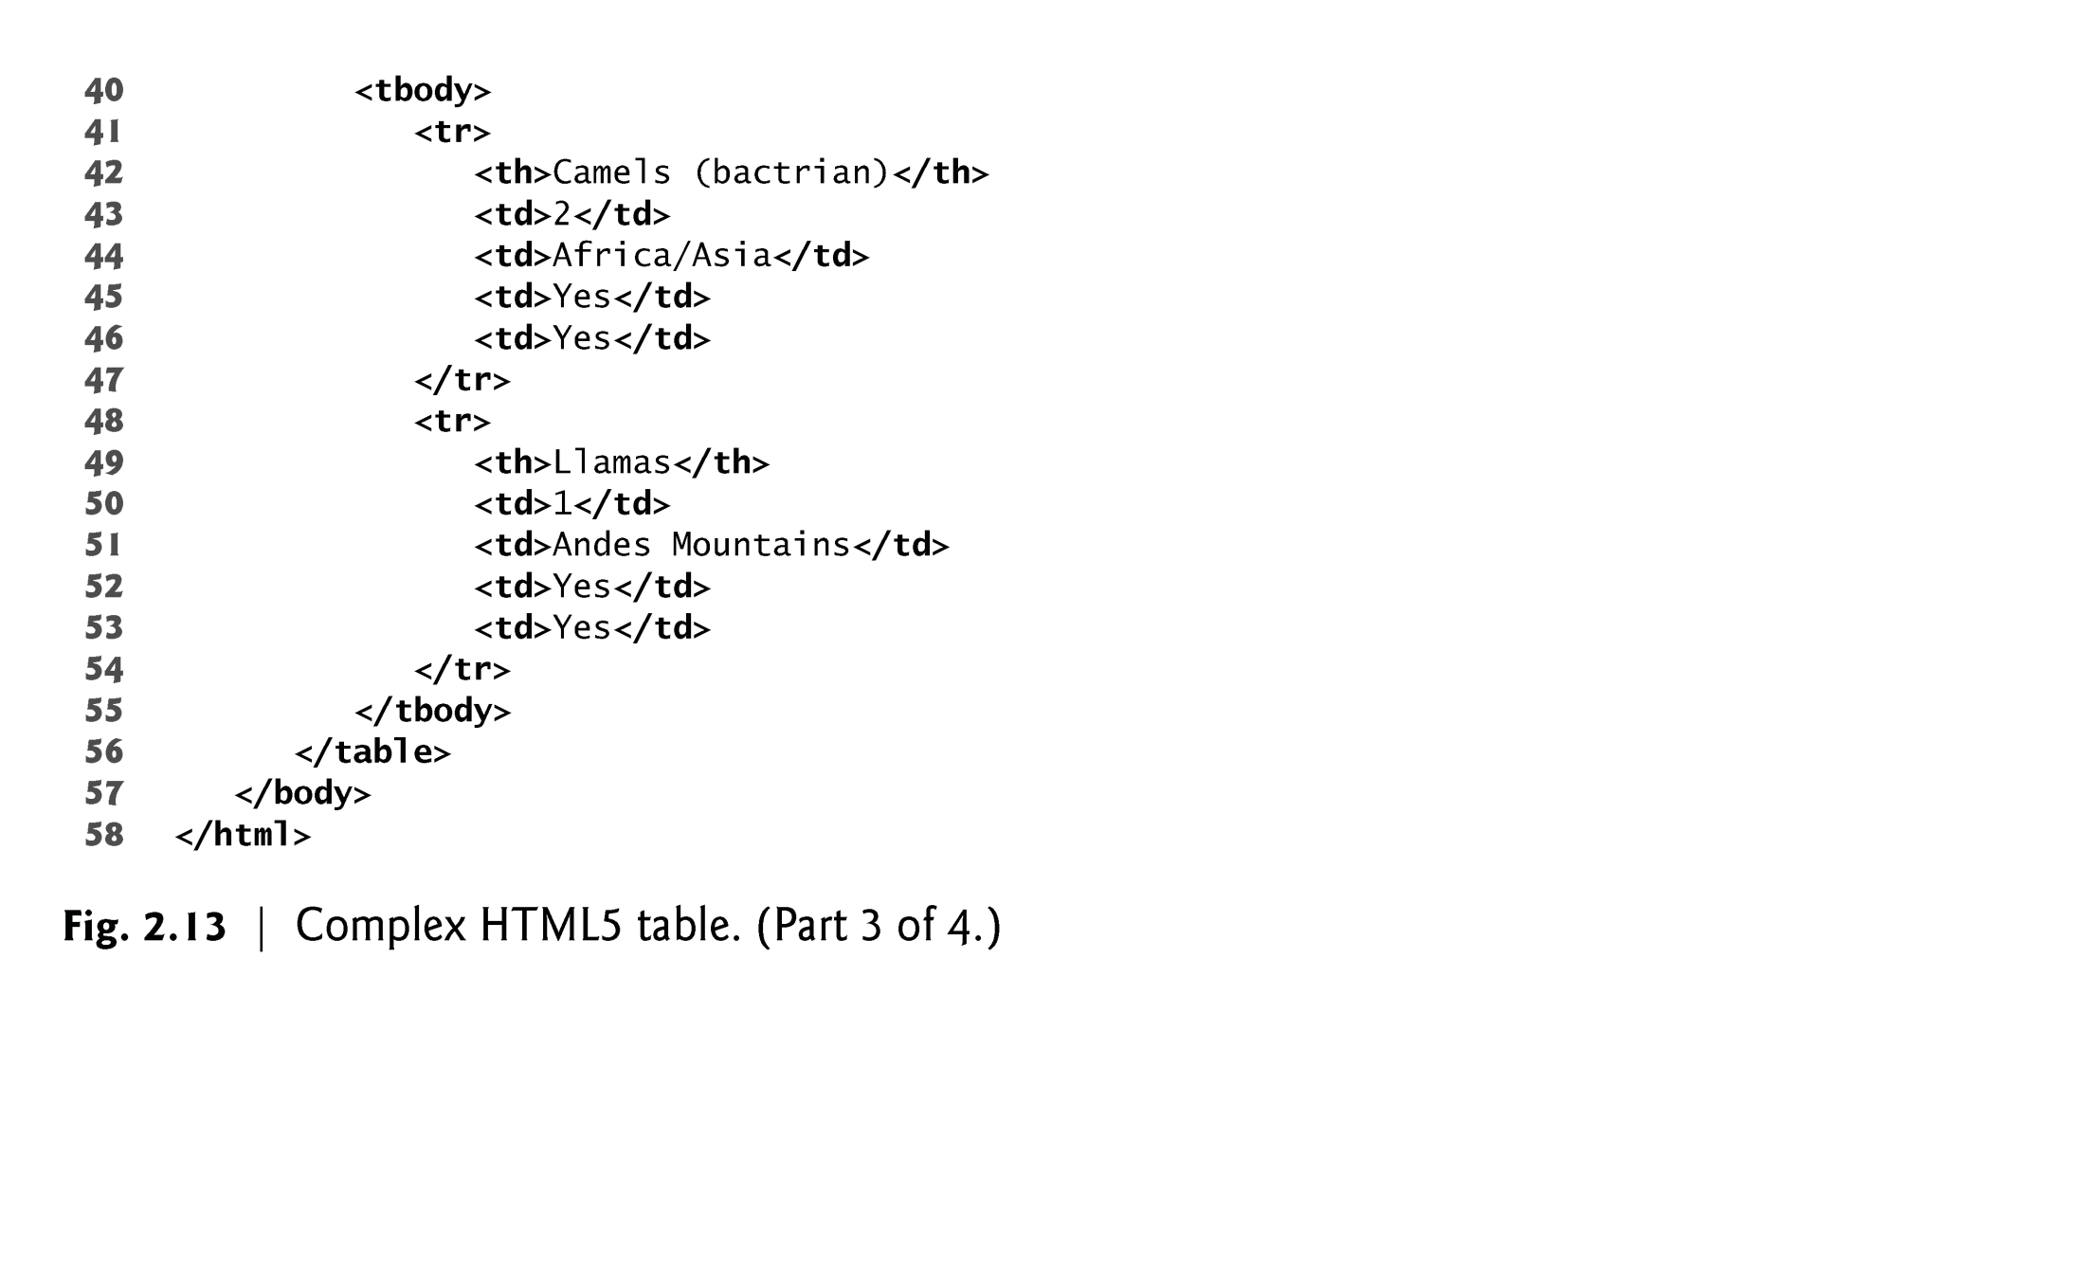

Slide 73
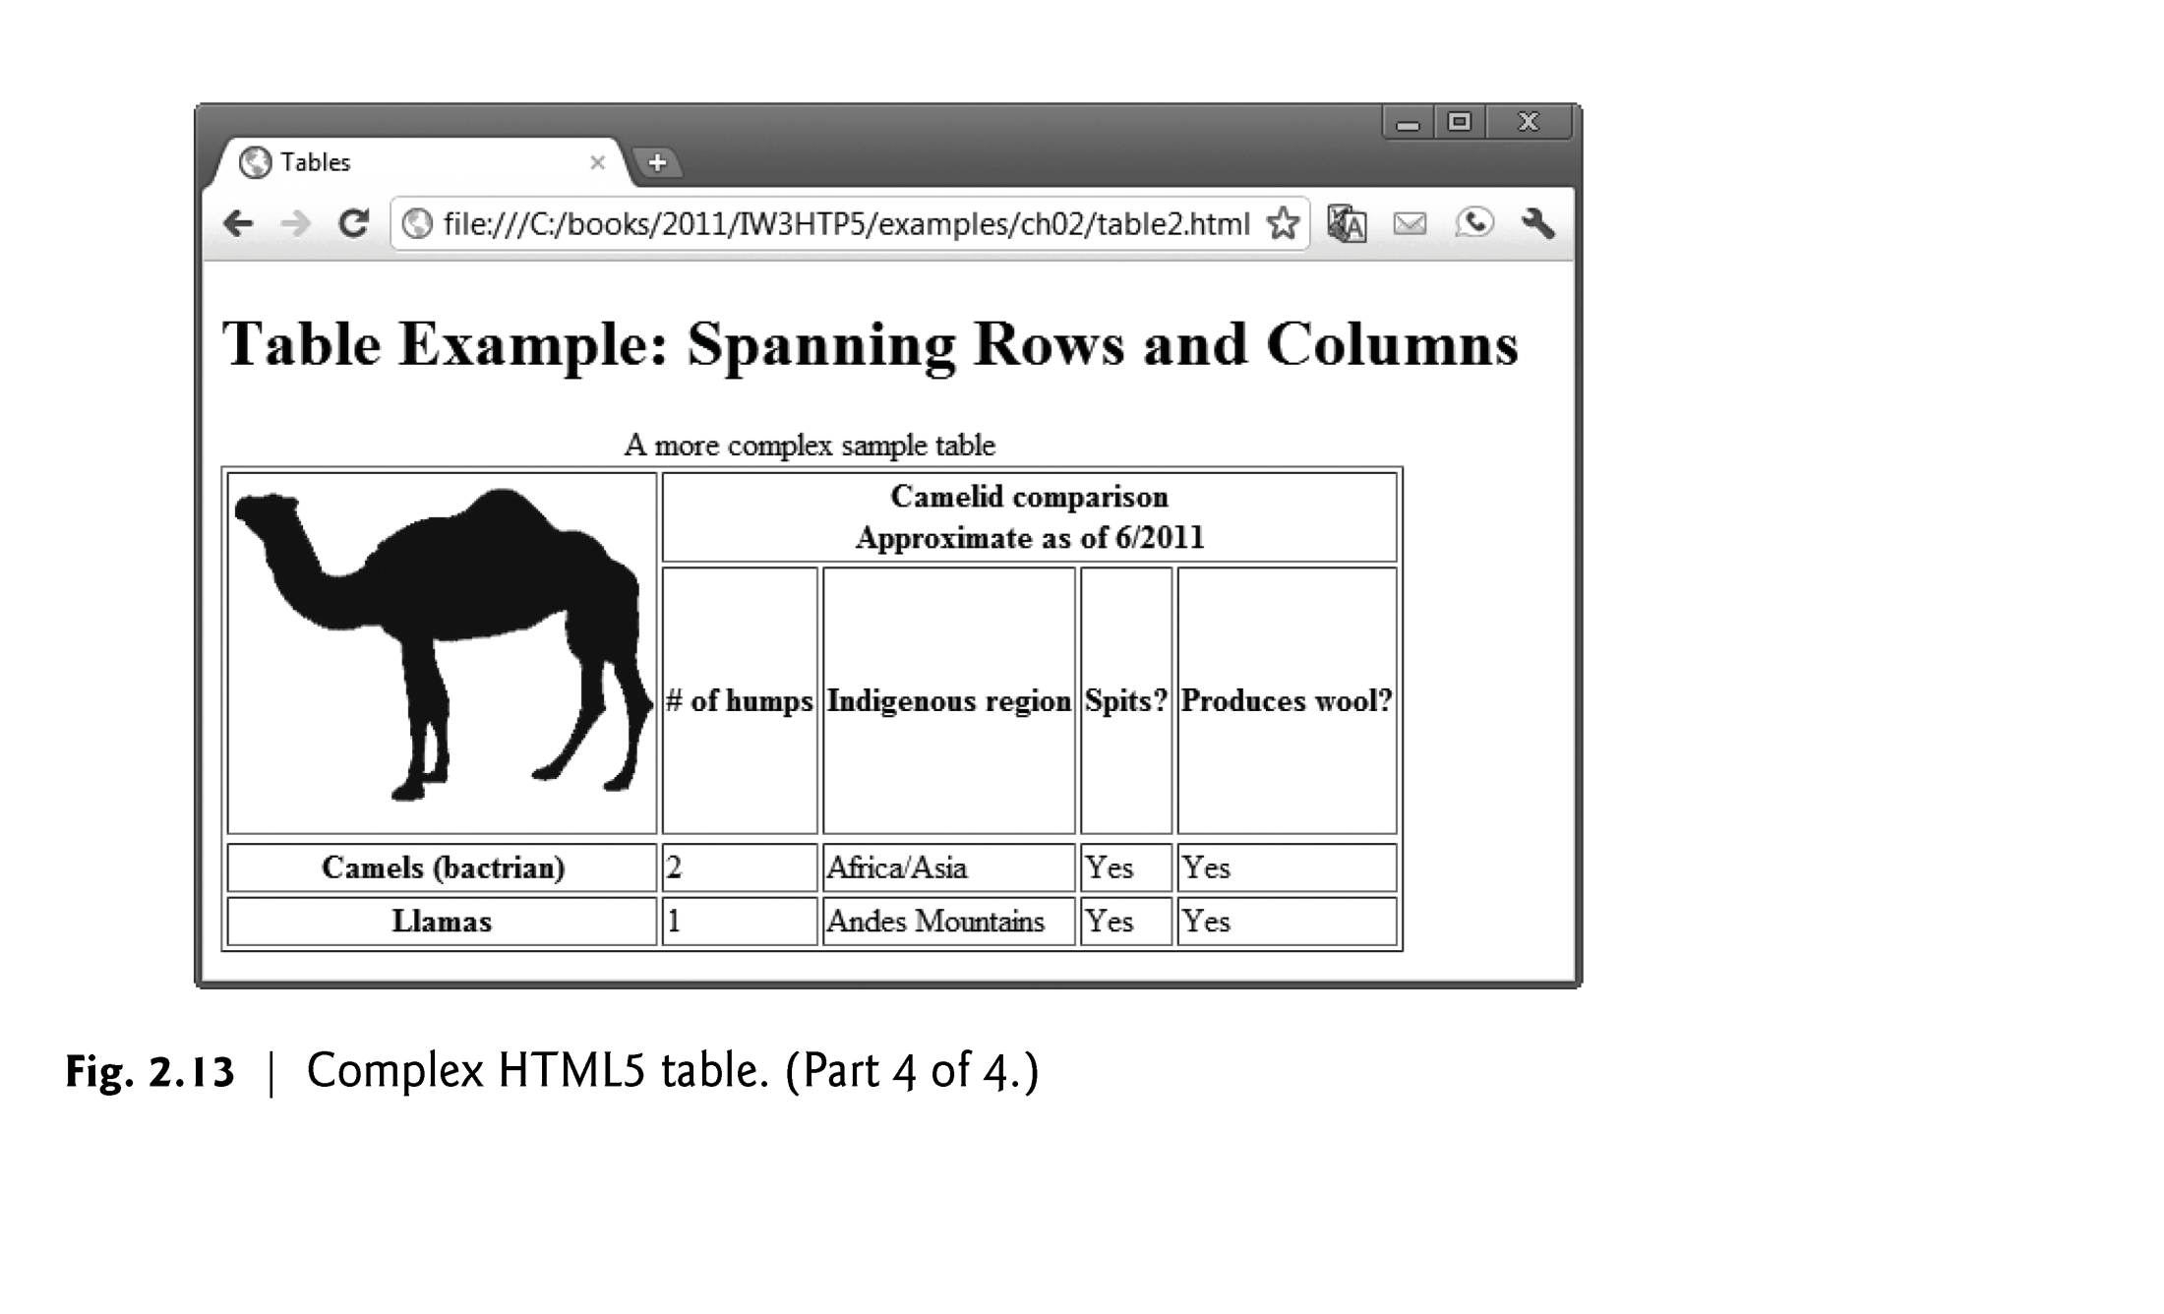

Slide 74
2.11 Forms
HTML5 provides forms for collecting information from users.
Figure 2.14 is a simple form that sends data to the web server for processing.

Slide 75
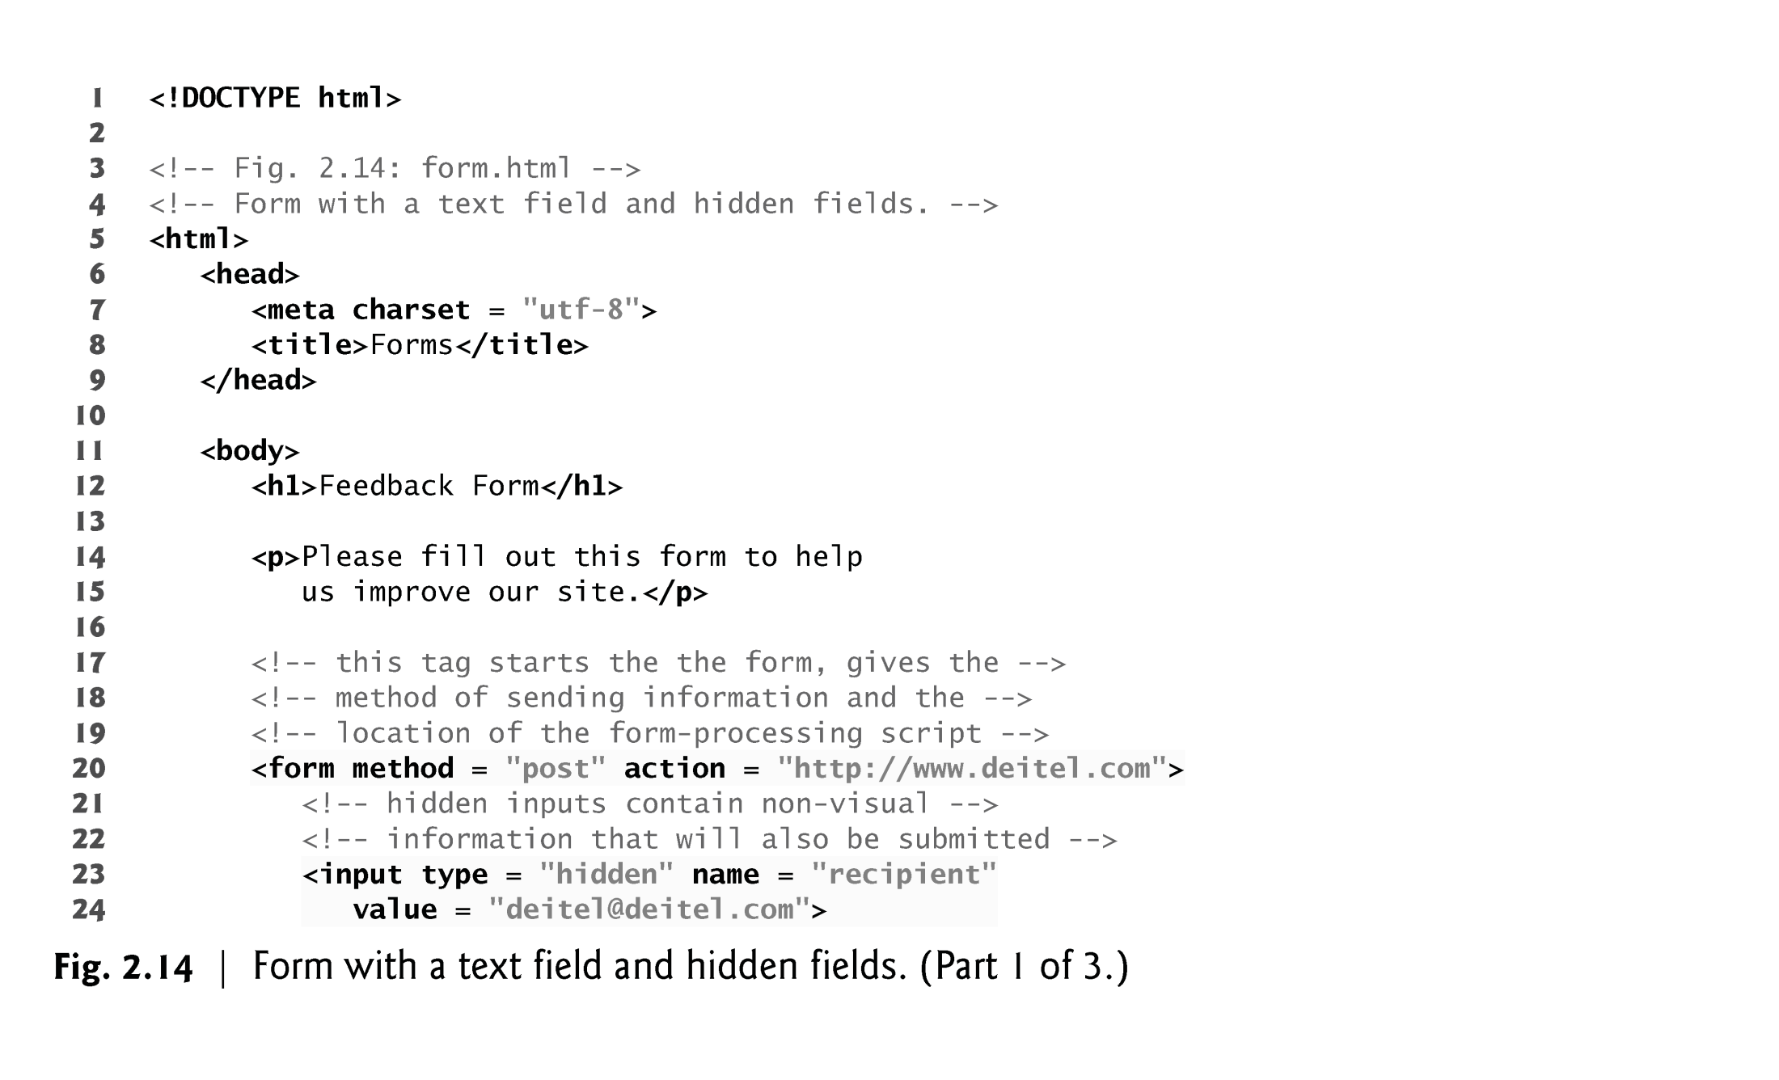

Slide 76
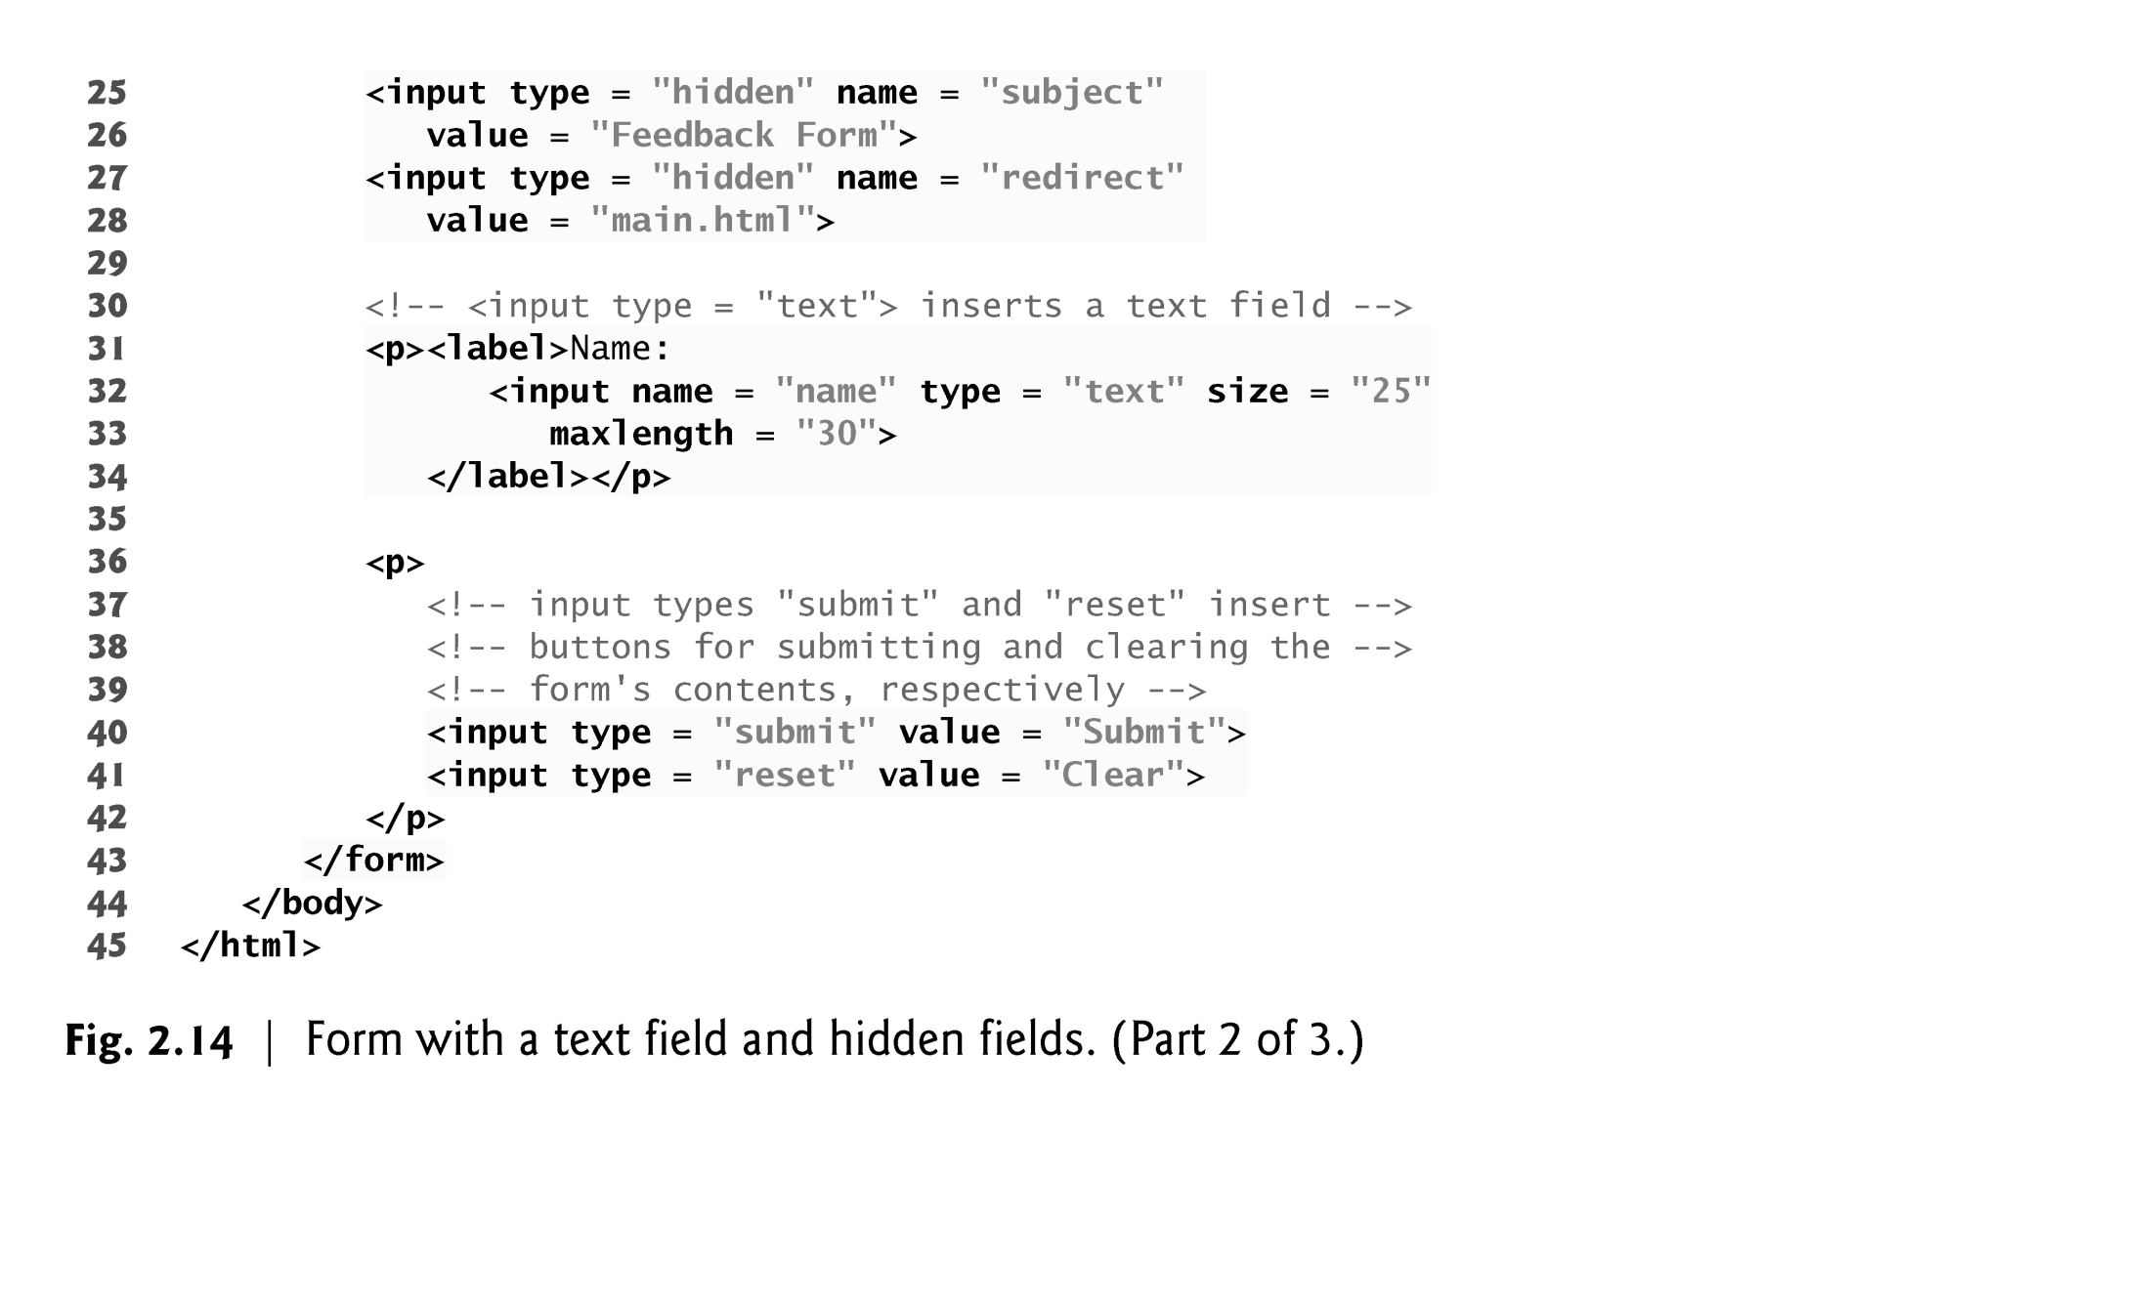

Slide 77
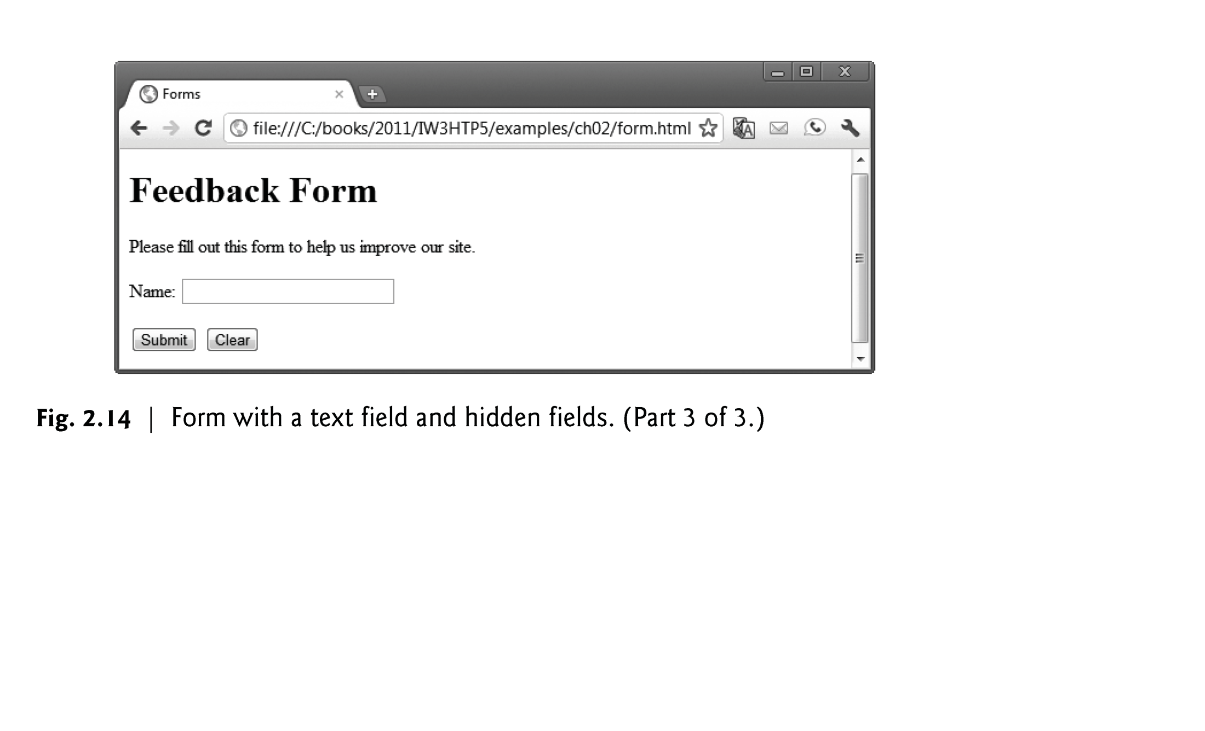

Slide 78
2.11 Forms (Cont.)
method Attribute of the form Element
A form is defined by a form element
Attribute method specifies how the form’s data is sent to the web server.
Using method = "post" appends form data to the browser request, which contains the protocol (HTTP) and the requested resource’s URL.
The other possible value, method = "get", appends the form data directly to the end of the URL of the script, where it’s visible in the browser’s Address field.
The action attribute of the form element specifies the script to which the form data will be sent

Slide 79
2.11 Forms (Cont.)
action Attribute of the form Element
The action attribute of the form element specifies the script to which the form data will be sent.
Since we haven’t introduced server-side programming yet, we set this attribute to http://www.deitel.com for now.
input elements that specify data to provide to the script that processes the form (also called the form handler).
An input’s type is determined by its type attribute.

Slide 80
2.11 Forms (Cont.)
Hidden Inputs
Forms can contain visual and nonvisual components.
Visual components include clickable buttons and other graphical user interface components with which users interact.
Nonvisual components, called hidden inputs, store any data that you specify, such as e-mail addresses and HTML5 document file names that act as links.

Slide 81
2.11 Forms (Cont.)
text input Element
The text input inserts a text field into the form, which allows the user to input data.
The label element provides users with information about the input element’s purpose
The size attribute specifies the number of characters visible in the text field.
Optional attribute maxlength limits the number of characters input into a text field.

Slide 82
2.11 Forms (Cont.)
submit and reset input Elements
The submit input element is a button.
When the submit button is pressed, the form’s data is sent to the location specified in the form’s action attribute.
The value attribute sets the text displayed on the button.
The reset input element allows a user to reset all form elements to their default values.

Slide 83
2.11 Forms (Cont.)
Additional Form Elements
Figure 2.15 contains a form that solicits user feedback about a website.
The textarea element inserts a multiline text area into the form.
The number of rows is specified with the rows attribute, and the number of columns (i.e., characters per line) with the cols attribute.
Default text can be specified in other input types, such as text fields, by using the value attribute.

Slide 84
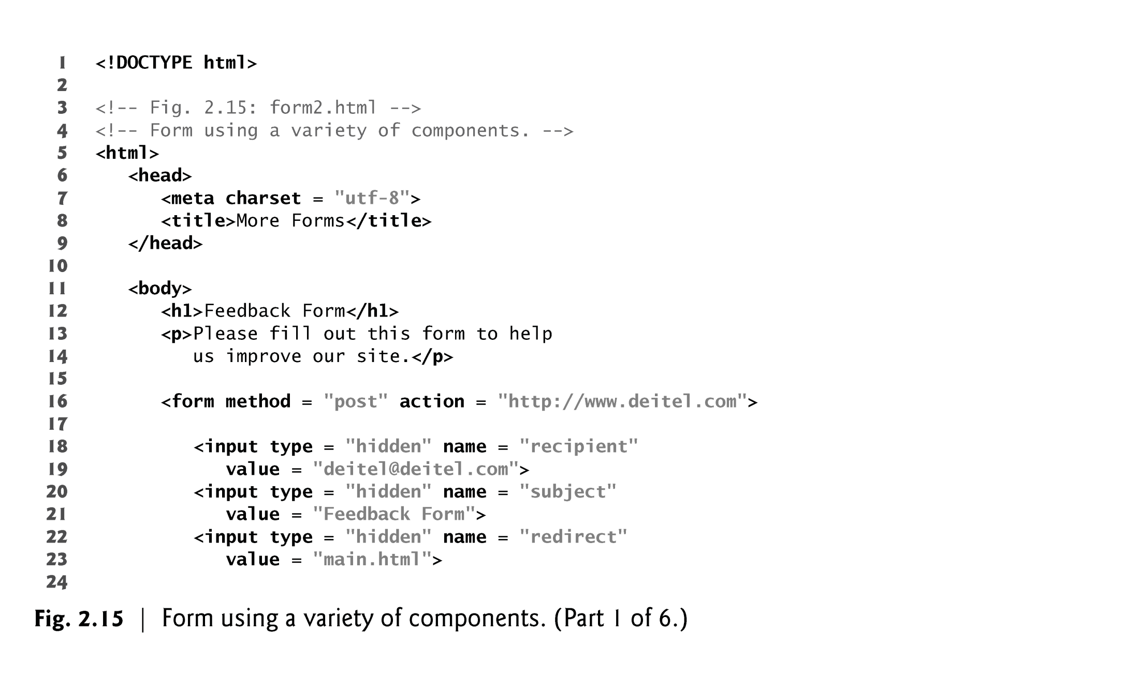

Slide 85
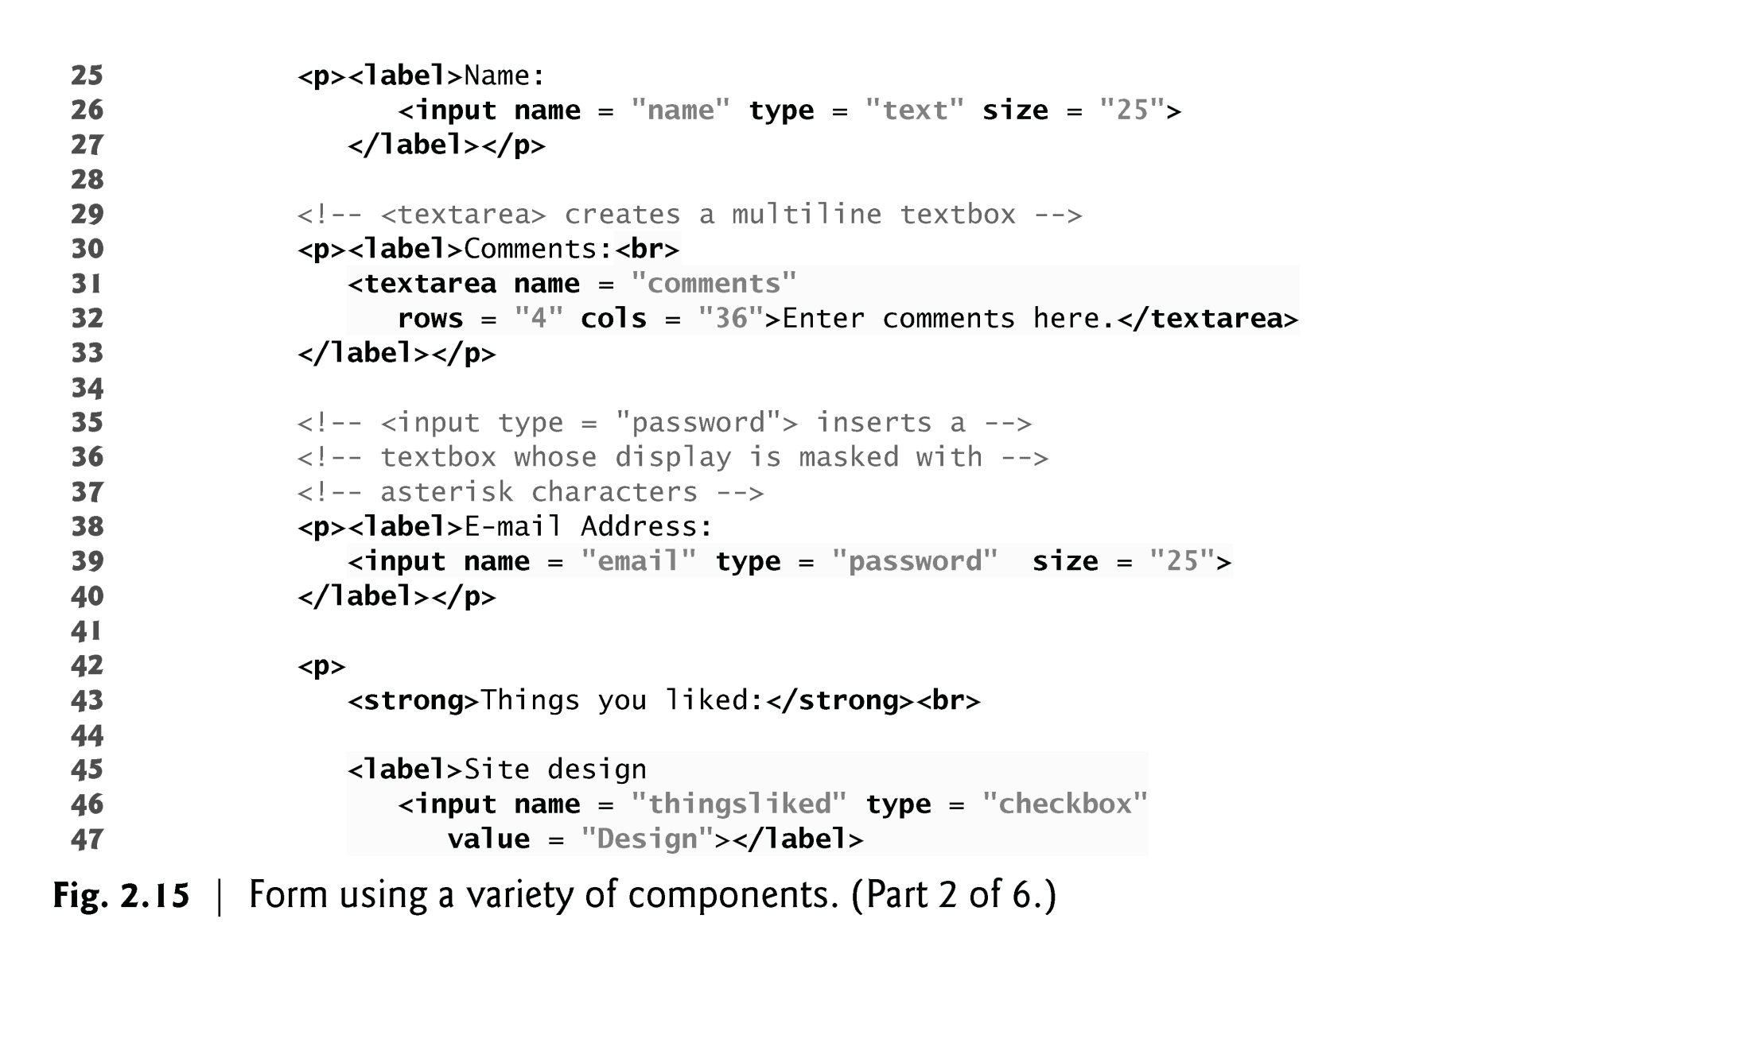

Slide 86
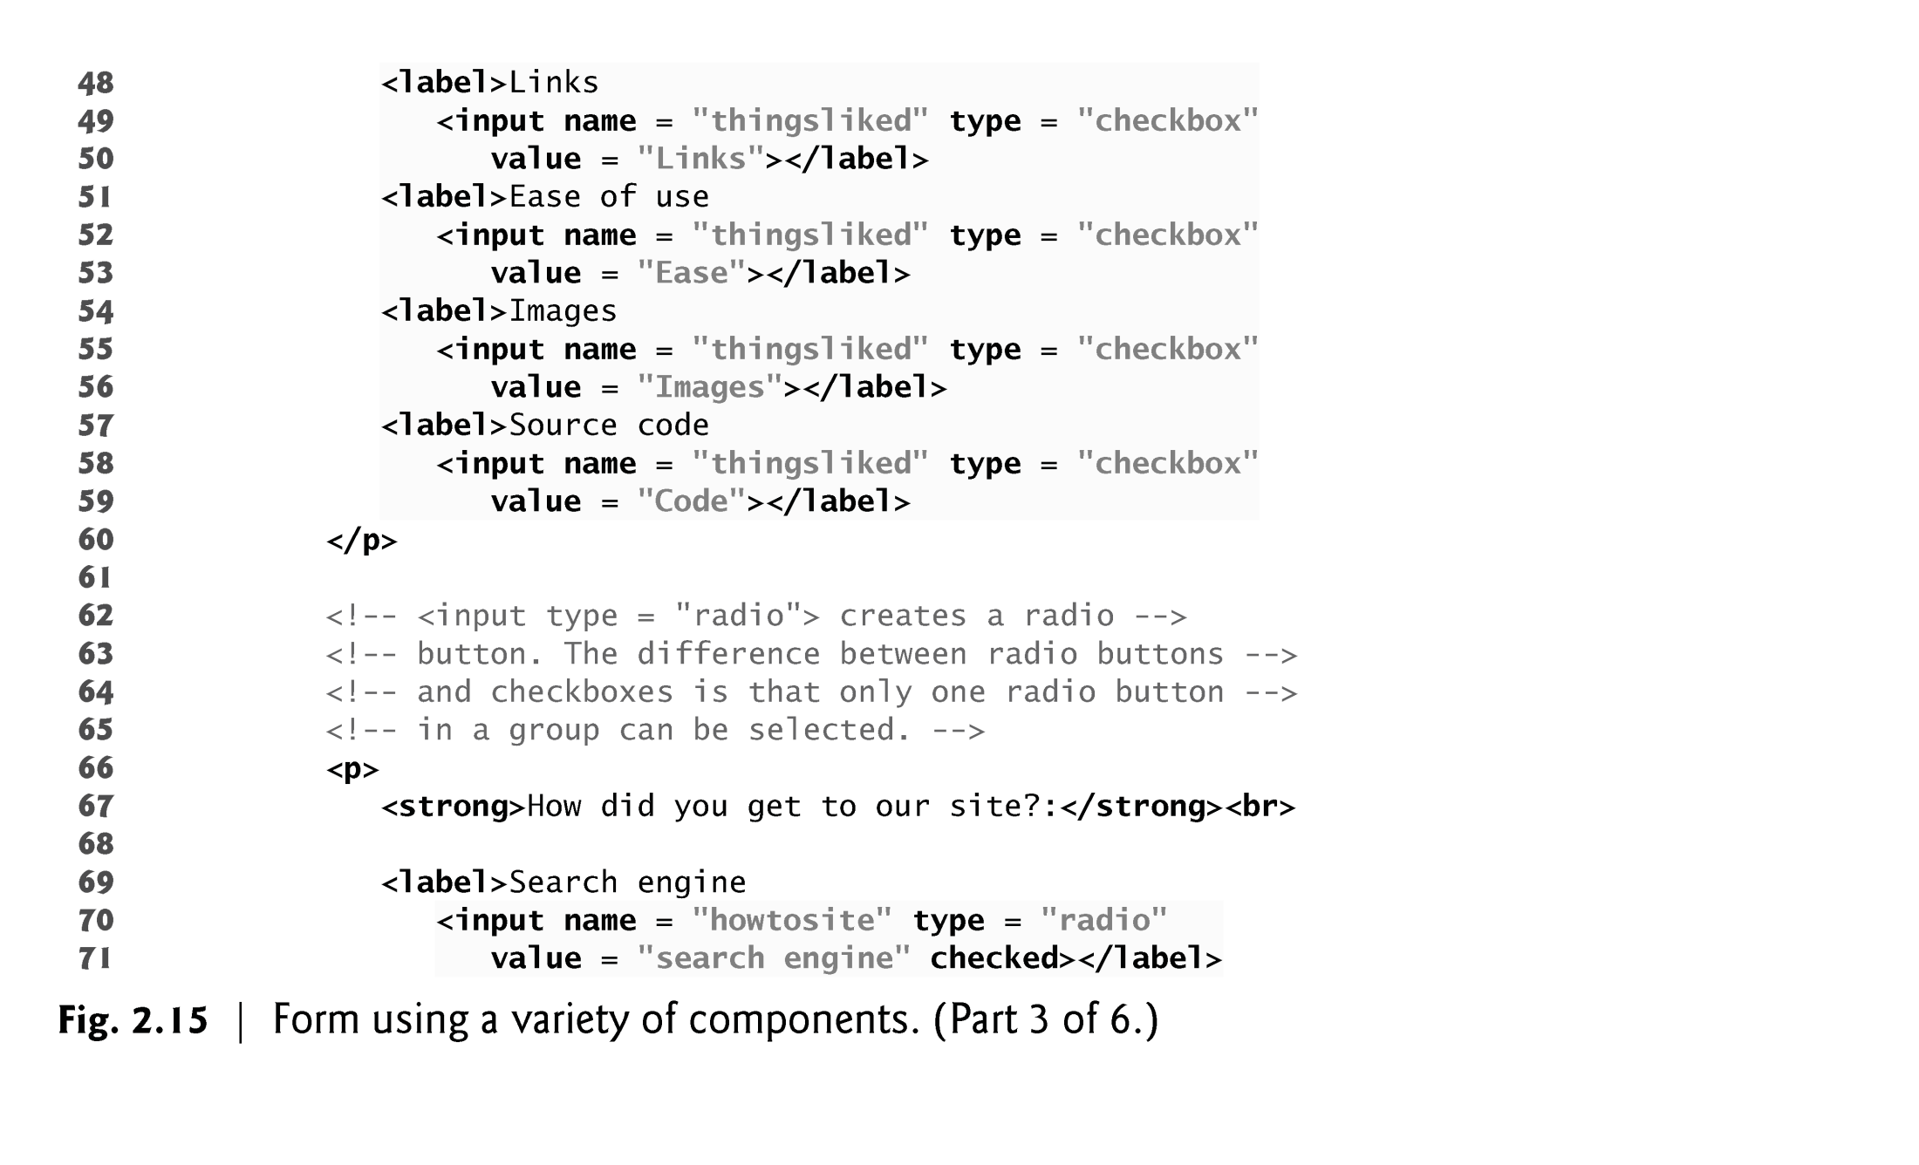

Slide 87
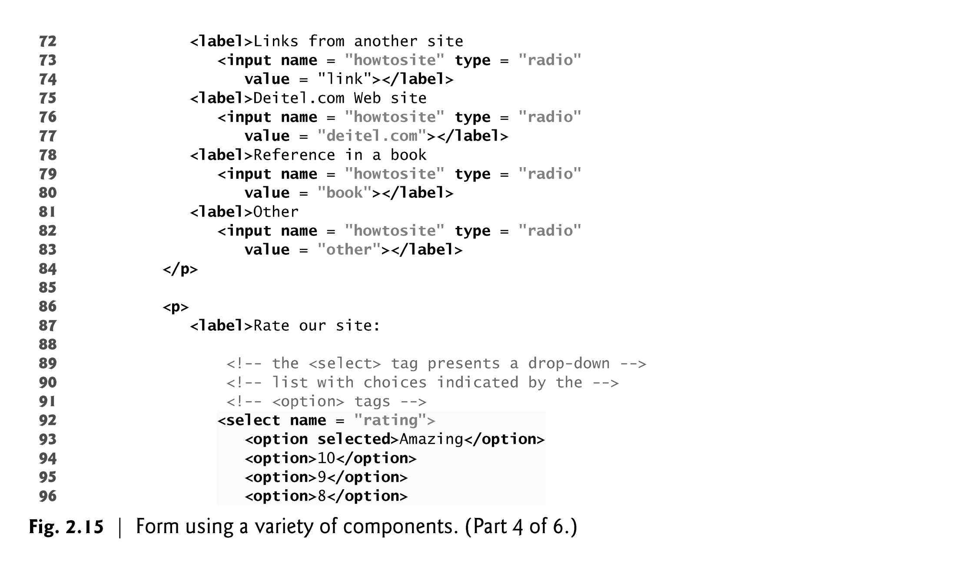

Slide 88
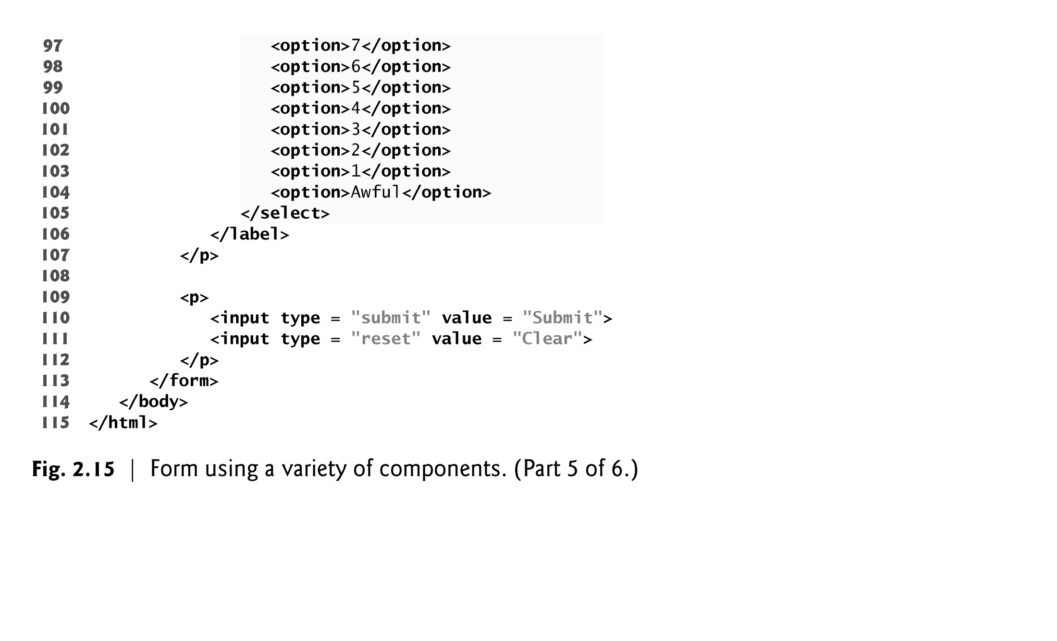

Slide 89


Slide 90
2.11 Forms (Cont.)
The password input inserts a password box into a form.
Allows users to enter sensitive information, such as credit card numbers and passwords, by “masking” the information input with another character, usually asterisks.
The actual value input is sent to the web server, not the asterisks that mask the input.

Slide 91
2.11 Forms (Cont.)
The checkbox input element enables users to select and option.
When the checkbox is selected, a check mark appears in the checkbox . Otherwise, the checkbox is empty
checkboxes can be used individually and in groups. checkboxes that are part of the same group have the same name
radio buttons are similar to checkboxes, except that only one radio button in a group can be selected at any time.
All radio buttons in a group have the same name attribute but different value attributes.
The select input provides a drop-down list of items.
The name attribute identifies the drop-down list.
The option element adds items to the drop-down list.

Slide 92


Slide 93


Slide 94
2.12 Internal Linking
The a tag can be used to link to another section of the same document by specifying the element’s id as the link’s href.
To link internally to an element with its id attribute set, use the syntax #id.

Slide 95


Slide 96


Slide 97


Slide 98


Slide 99


Slide 100
2.13 meta Elements
One way that search engines catalog pages is by reading the meta element’s contents.
The name attribute identifies the type of meta element
The content attribute
Of a keywords meta element: provides search engines with a list of words that describe a page, which are compared with words in search requests
Of a description meta element: provides a three- to four-line description of a site in sentence form, used by search engines to catalog your site. This text is sometimes displayed as part of the search result

Slide 101


Slide 102


Slide 103


Slide 104


